Slide 1
Collaborative Efforts in Spokane – Coeur d’Alene
University of Idaho & Washington State University

Slide 2
Timeline of Collaboration
Summer 2009: One-on-one meetings with public officials
Summer 2009: ULTRA-Ex Proposal (urbanizing & development)
March 2010: workshop (~60 government, business and non-profit leaders)
  Participants identified water and social dimensions
April 2010: submitted WSC proposal to NSF
June 2010: Follow-up workshop
August 2010: Received Water, Sustainability and Climate planning grant
2010-11: Information Gathering for project and proposal development

Slide 3
Pre-planning (2009-10)
Planning
(2010-2011)
Collaboration
(2012-14)
Held individual meetings and workshops to better understand local issues and concerns
Identified potential opportunities for collaboration (including current Water Sustainability and Climate planning grant)
Active planning and information gathering to better understand the interactions between water needs and people
Target specific sources of funding to acquire support for research opportunities in the area
Build relationships and identify our best opportunities to work with others on applied, results-oriented projects
Collaboratively collect relevant information: surveys, citizen interviews, educational materials and efforts
Sustained Effort (2014-2024)
The results from these collaborations will serve as the foundation for other opportunities to work together on a host of other regional issues
Sustained efforts will increase likelihood of building a corridor of communities with a high quality of life
Collaboratively establish priorities for research in the biological and physical sciences including hydrology, nutrient and contaminant transport

Slide 4
WSC Organizational Structure
Collaborative Team
Water Processes
Human Dimensions
Scientific & Community Partners
3) Integrating Human / Water Dynamics (Allyson Beall)
Water Quantity
Perceptions of Water (Todd Norton)
Institutional Decision-Making (Sandra Pinel)
Organizational Networks (Manoj Shrestha)
Water Quality
Todd Norton (WSU)
Jim Gosz (UI)
Scientific Professional Advisory Board

Slide 5
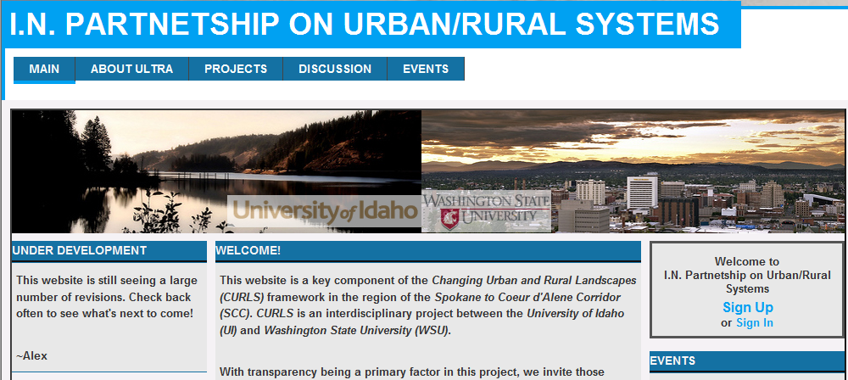
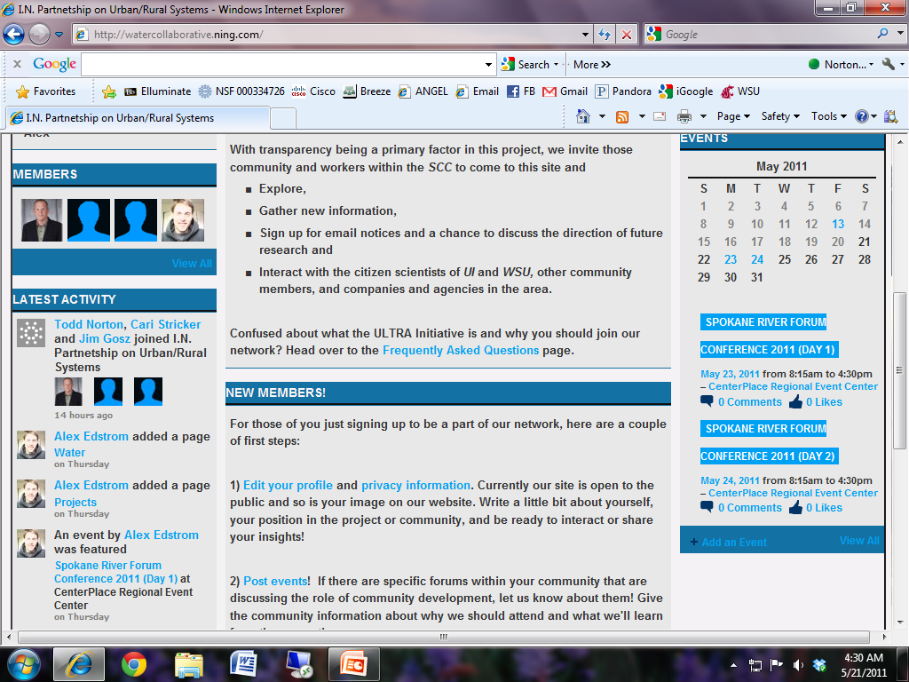
inlandpartners.ning.com

Slide 6
UI and WSU: Information Gathering in the Spokane - Coeur d’Alene Corridor
In this planning phase we are meeting with a wide range of people directly and indirectly involved in water and development in the Spokane and Coeur d’Alene region. Our ongoing efforts include:
Water scientists: from universities and agencies to familiarize ourselves with present and likely future issues associated with water in the region including presently available data and any potential needs in those data sets.
Business owners: from the corridor to understand how they, leaders in development, see water impacting them now and potentially in the future.
Planners and Public Officials: from the corridor to understand development decision making both within and across jurisdictions.
Leaders: involved in water and water-related decision from private, public and non-profit organizations to understand how these organizations network with one another.
Members of public: engaged in water issues to understand the sorts of changes they perceive in the area’s natural amenities.
Water managers: from public agencies, private businesses and non-profit organizations to understand perceptions, values and management strategies about water.

Slide 7
Snapshot of Human Dimensions Efforts

Slide 8
Interviewing Planners/Managers
WA and Idaho
Nine graduate students,14 interviews with planners and program managers – city, county, state.
Six questions:
Perceived scale of the region, the actors, the obstacles to regional water resource management, and the strategies staff use across political boundaries?
Costs of growth: cost & delays urban wastewater and continued rural wells and septic tanks
Land use policies city/county/state diverge
Storm water runoff adds to wastewater plan limitations
Complex management goals – public/private – short-term fixes
Litigation, water rights
GMA/Idaho county obligations and lack of $ - inefficiency
Connections aquifer/surface
Bi-state federal/tribal rules
Interviews
Shared Concerns
Notes:
One county in WA, explaining that with GMA, new growth is annexed and supports urban service extensions, but counties must treat pre-existing urban development that is not in cities – no money to do so. New plant opening postponed to 2012
The adaption of WA standards for ID by the EPA causes conflict
Comments about AVISTA and long lake.
Lots of short term

Slide 9
“We need a regional council”. “Involve the MPO!”
“Interaction [on water issues] is seamless across the borders”
“Local governments push state and federal agencies for collaboration, stakeholders push regulators to work together” a “interaction is seamless across the border” [among staff]
“Legal and political debates get stuff done”
“I would argue that most water conflicts are about money – financial use of the water”
Currently regeneration is not a concern for the aquifer, but we want to protect the balance that we have with the aquifer.”
“We feel that water is a part of our everyday life, and our water affects the city downstream.”
“The population is divided between those with golf courses and those without…friction and resentment.”
“The foundation has been laid, but it’s a challenge to keep it going, there is a lot of cooperation involved even though a lot of times it’s cities vs. counties.”
Notes:
How do we , a state agency, balance consistency with flexibility?

Slide 10
Strategies
Decision drivers:
  Finance services & respond to development
  Need to collaborate because of different agency responsibilities; compliance, streamline rules
  Expect shortages in seven years
Some Strategies and Recommendations
  Local governments want state/fed agency rules aligned – keep regional agencies
  Regional efforts (ex. Rathdrum Prairie Aquifer)
  Support watershed planning units/education
  Rationalize fees for water use
  Change 2-year political thinking to 20-year thinking
  Interconnect small city/special district planning

Slide 11
Management and protection of the SV-RP Aquifer and adjacent contributing watersheds
Barriers to collaboration | Mean rating
Free-riding problem | 4.13
Lack of information | 4.57
Information asymmetry | 4.27
Information uncertainty | 4.40
Monitoring difficulty | 4.39
Divergent interests | 5.46
Short-term priority (interest) | 4.86
Necessary funding | 5.84
Technical expertise | 3.76
Regulatory obstacles | 5.10
Political buy-in (support) | 5.25
Response category | Mean rating
Level of importance | 6.63
Pro-growth vs pro-environment | 5.62
Has your organization been active? | 70%
Level of satisfaction about collaborative efforts | 4.65
Level of trust | 5.15
Preliminary results from the survey of organizations working in the region. Survey conducted in Spring 2011. Response rate 34.5 %. Rating scale: 1 to 7.

Slide 12
Perceptions of Water Systems
Fall 2010
Undergraduates interviewed 120 leaders in development-related businesses (realtors, landscapers, land developers, and so forth)
Spring 2011
Forty undergraduates worked with Spokane County
Learned a lot about water systems throughout the region
Interviewed 30 water experts to understand perceptions of how systems worked, interacted and priorities

Slide 13
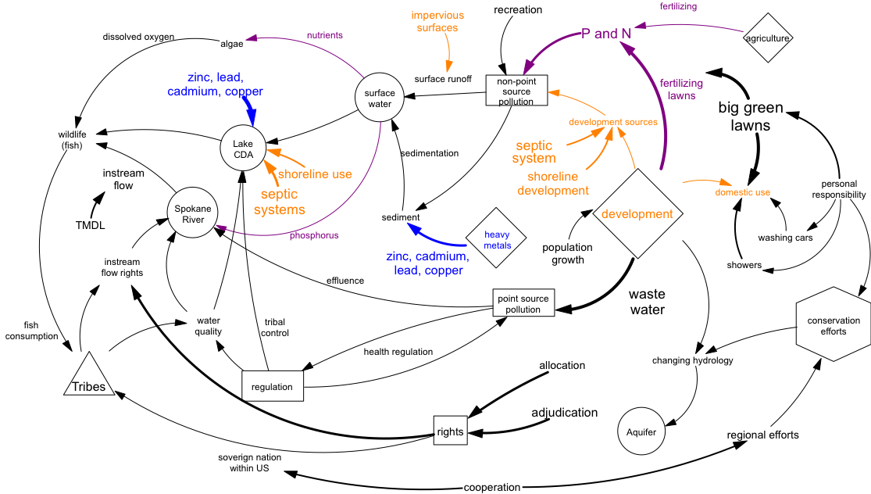
Expert Map

Slide 14
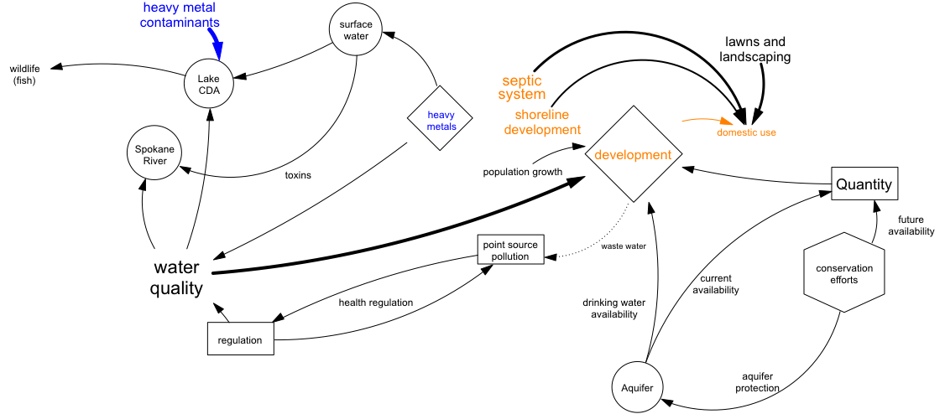
Development Map

Slide 15
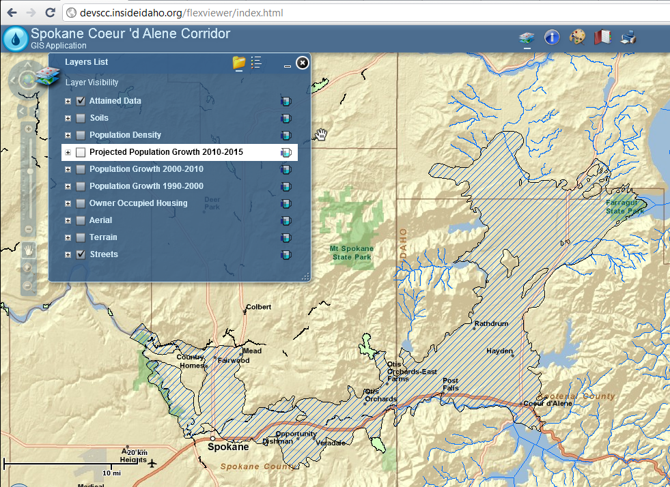
Users may request
additional layers
Interactive GIS:
http://devscc.insideidaho.org/flexviewer/index.html
Allow users to look at various location within the Aquifer region to get a bigger picture of the region and current land uses, projected population changes, etc.

Slide 16
Ongoing Collaborative Efforts
Current and Future Possible Proposal Outlets

Slide 17
Pending Proposals
NSF - Program on Law and Social Science
Supports social scientific studies of law and law-like systems of rules, institutions, processes, and behaviors. UI pending proposal on a Workshop on Resilience in Water Governance
NSF – Integrated Graduate Education and Research Traineeship
IGERT is the National Science Foundation’s flagship interdisciplinary training program, educating U.S. Ph.D. scientists and engineers by building on the foundations of their disciplinary knowledge with interdisciplinary training. Both UI and WSU have proposals which integrate natural and human dimensions. If awarded, either would provide opportunities to have well funded graduates working closely on locally-initiated projects over the next 5 years.

Slide 18
Future Potential Proposal Outlets
NASA – Impacts of Urbanization of the Environment
Characterize and Model the impacts of urbanization on the atmospheric, hydrologic, biological and socioeconomic aspects of the surrounding environments.
NSF - Hydrologic Sciences
Hydrologic Sciences focuses on the flow of water and transport processes within streams, soils, and aquifers.
NSF - Ecosystem Studies
Supports investigations of whole-system ecological processes and relationships to advance understanding of the relationships between structure, including complexity, and functioning of ecosystems through time.
NSF - Dynamics of Coupled Natural and Human Systems (CNH)
Promotes interdisciplinary analyses of relevant human and natural system processes and complex interactions among human and natural systems.

Slide 19
NSF/USDA/USFS - Urban Long Term Research Area (ULTRA)
Enable teams of scientists and practitioners to conduct interdisciplinary research on the dynamic interactions between people and natural ecosystems in urban settings in ways that will advance both fundamental and applied knowledge.
NSF - Water Sustainability and Climate
Studies of the water system using observations at specific sites in combination with models that allow for spatial and temporal extrapolation and integration across the different processes in that system to advance the development of predictive understanding.
HUD - Sustainable Communities Regional Planning Grant Program
Support metropolitan and multijurisdictional planning efforts that integrate housing, land use, economic and workforce development, transportation, and infrastructure investments in a manner that empowers jurisdictions to consider the interdependent challenges of (1) economic competitiveness and revitalization; (2) social equity, inclusion, and access to opportunity; (3) energy use and climate change; and (4) public health and environmental impact.

Slide 20
Collaborative Proposals
Are there useful roles the team and universities could play on community-initiated proposals?

Slide 21
Collaborative Efforts in Spokane – Coeur d’Alene
University of Idaho & Washington State University

