Slide 1
Shoreline Management in Washington State
Spokane River Forum
May 23rd, 2011

Slide 2
Presentation Goals
Provide an overview of Washington State’s approach to shoreline management.
Discuss community & environmental benefits of shoreline master programs.
Answer your questions (or at least try to!)

Slide 3
Shoreline Management Act (SMA)
Passed by the Legislature in 1971; voters approved through a referendum (statewide vote) in 1972.
Three basic policies:
1. Protect the environmental resources of state shorelines.
2. Promote public access and enjoyment opportunities.
3. Give priority to water dependant uses.

Slide 4
Shoreline Management Act (SMA)
City or County
Shoreline Master
Program (SMP)
173-26 WAC
Shoreline Master Program Guidelines
RCW 90.58
Shoreline Management Act
Ecology’s SMP
Guidebook

Slide 5
Why Are We Updating SMPs Now?
Negotiated settlement in 2003 between diverse interest groups.
Refined standards for updating shoreline master programs.
Deadlines for updates established in RCW 90.58.
New Key Standards:
  “No Net Loss” of ecological functions
  Restoration planning
  Assessment of “reasonably foreseeable” cumulative impacts

Slide 6
Local‐State Partnership
Cities and Counties
Lead shoreline planning within jurisdictional boundaries.
Prepare, adopt, & administer locally‐crafted shoreline master programs.
Keep shoreline master programs current.

Slide 7
Local‐State Partnership
Ecology
Provides “Guidelines” outlining essential elements of shoreline master programs. (WAC)
Provides technical support and grant funding.
Director must approve each local master program before it can take effect.
Once a SMP is approved by a city or county & Ecology, the state is a full partner in implementing the program.

Slide 8
Comprehensive SMP Updates Include:
Extensive citizen involvement
Inventory & use analysis of shorelines
Shoreline goals, policies & environment designations
Shoreline regulations & standards
Permit administration & enforcement provisions
Local adoption through open public process
Ecology review & approval before effective

Slide 9
An SMP Update Will:
Allow for appropriate and strategic new development to occur.
Respect private property rights.
Provide more certainty to the development community.
Preserve shoreline areas and increase public access.
Safeguard fish and wildlife habitat and improve water quality.

Slide 10
An SMP Update Will Not:
Take away existing private property rights.
Require legally existing shoreline homes to be relocated.
Require legally existing uses to be discontinued.
Apply retroactively – The starting point is the date Ecology approves the amended program.

Slide 11
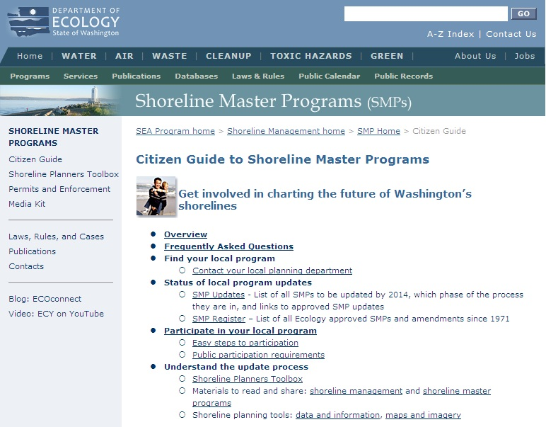
Contact & Online Information
Ecology’s SMP Citizen’s Guide:
www.ecy.wa.gov/programs/sea/shorelines/smp/
citizen.html
Jaime Short
Shoreline Planner
509.329.3411
jaime.short@ecy.wa.gov

