Slide 1
ABC’s of PCB’s
“In A Near Nature but Not So Perfect Situation”
So many PCB’s!
Global production - 1930’s - 1980’s
Greater than 1.5 Million Tons
U.S. Production 600,000 Tons
1970’s – 1980’s Initiating Controls on PCB’s
Spokane River Standards:
  170 parts per Quadrillion for Ecology
  3.37 parts per Quadrillion for Spokane Tribe

Slide 2
Transport Into the Environment
PCB’s have a low vapor pressure allowing water to Dissolve PCB’s
PCB’s have an ability to grasp particles
Air transportation of PCB’s especially those simpler forms with/1-4 chlorine atoms
Ventilation of PCB’s containing air from buildings

Slide 3
Getting Rid of PCB’s
Incineration
Microbial
Chemical

Slide 4
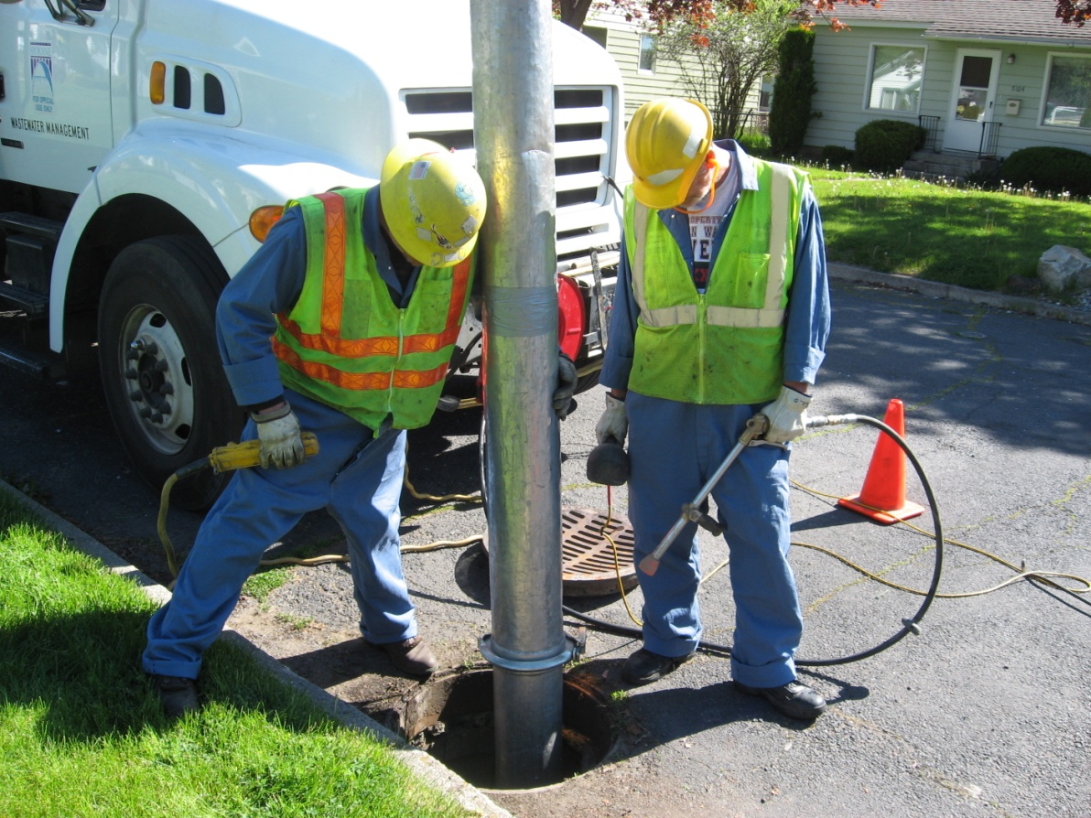
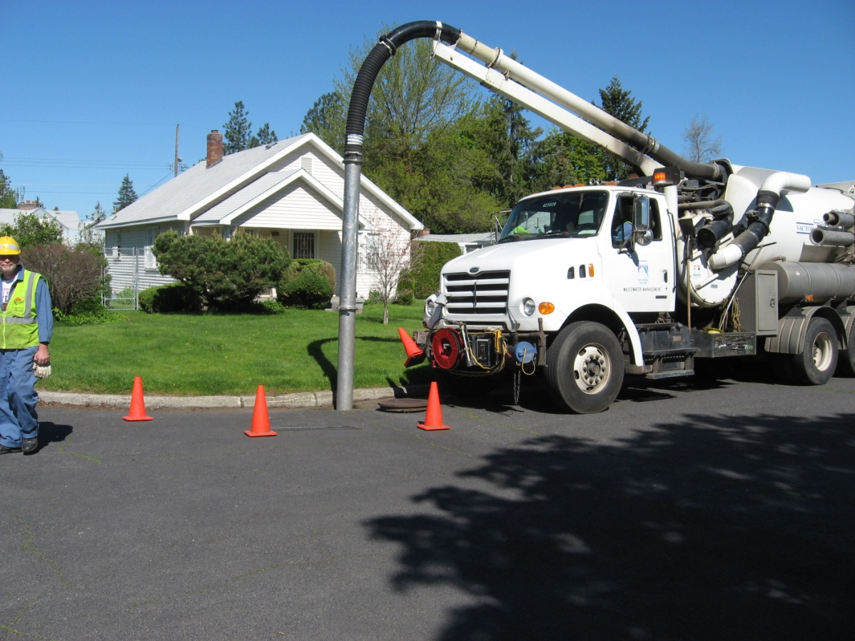
Cleaning PCB’s Up
Pictures of Our Vactors

