Slide 1
Who’s Doing What??
“The Spokane River does not meet the State’s standards and is on the 303 ‘D’ List”.

Slide 2
City of Spokane’s Situation
1,200 miles of sewer lines
400 miles of separate stormwater lines
100 discharge points of stormwater
Over 20,000 catch basins

Slide 3
Clean-Up and Removal
Highest First - Industrial - Commercial
431 catch basins
278,000 lbs of residue = 25 gr. PCB’s

Slide 4
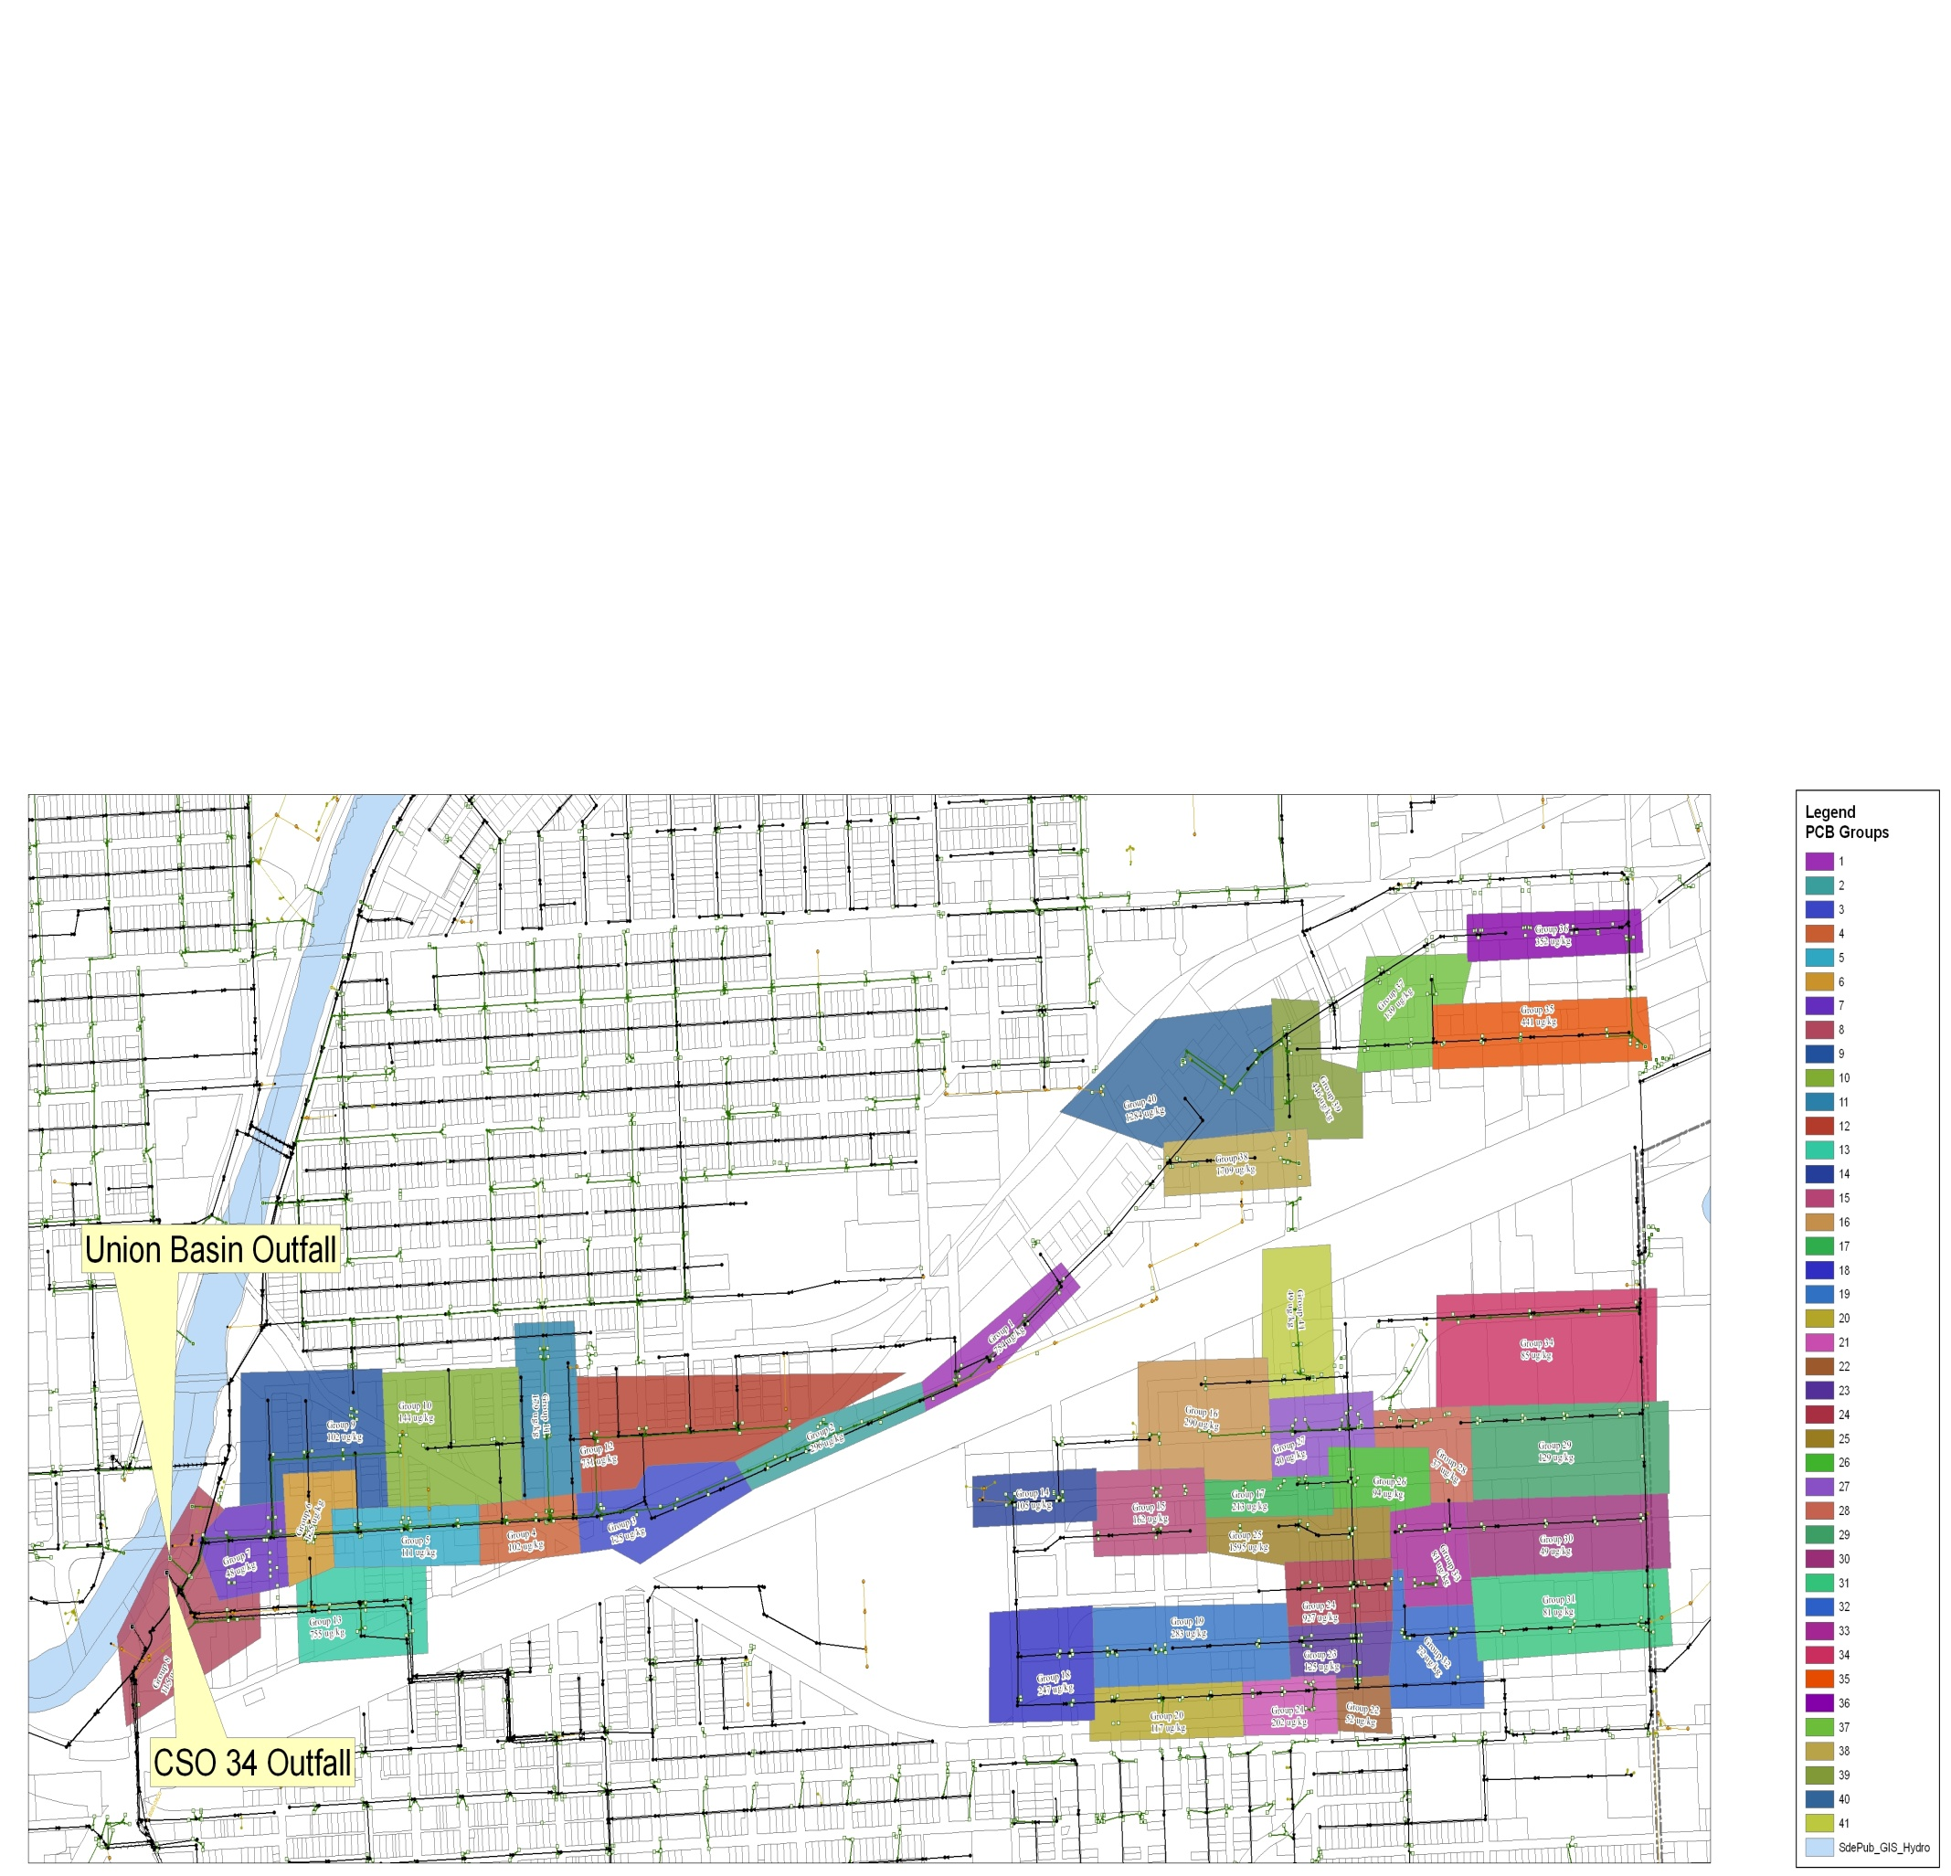
431 Catch basins resulting in 41 groups

Slide 5
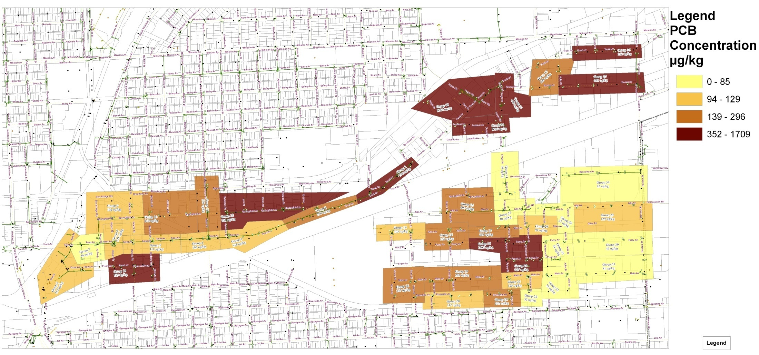
PCB Concentration

