Slide 1
Spokane Basin Urban Waters Update
By Arianne Fernandez
WA Dept of Ecology
May 2011

Slide 2
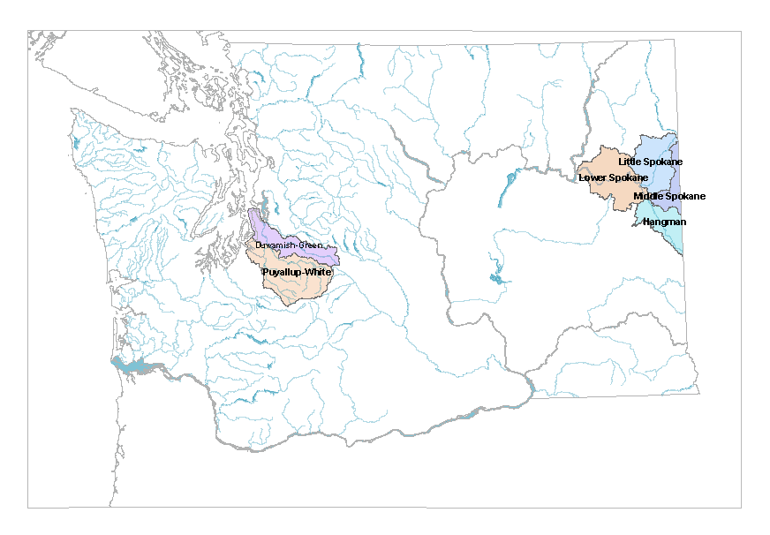
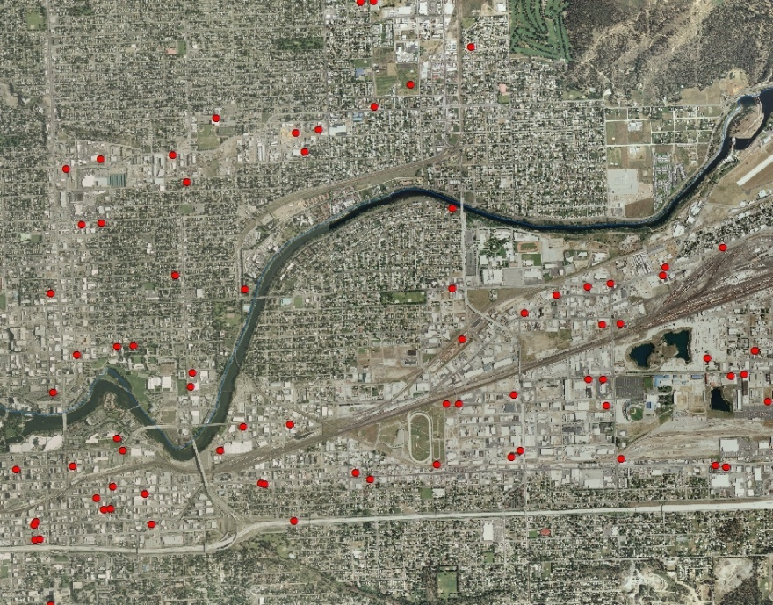
2007 Urban Waters Initiative
Increased focus of Ecology resources on three Urban Water areas
Spokane River
…to reduce toxic chemical pollution from stormwater runoff and other sources.
Notes:
Money provided to Ecology from the legislature to pilot a clean up effort using tools we haven’t had available to us in the past.

Slide 3
Integrating Three Priorities
HWTR
Prevent Toxic Contamination
WQ
Prevent Harm From Stormwater Runoff
Local Source Control Specialist Partnership
Urban Waters Initiative
TCP
Cleanup Contaminated Sites and Sediment
Spokane Regional Health District
Notes:
Increase efforts to clean up what we know about.
Find and prevent point and nonpoint source contamination to prevent recontamination as they had happen in the Duwamish Waterway.

Slide 4
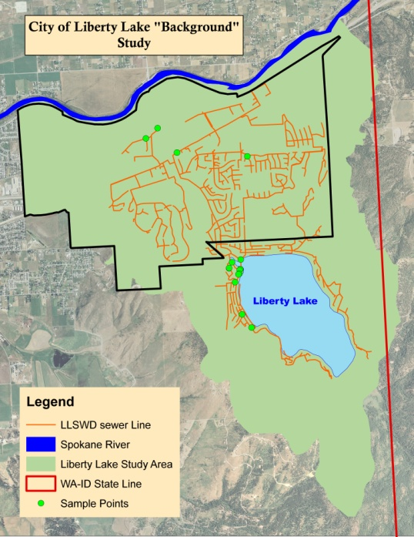
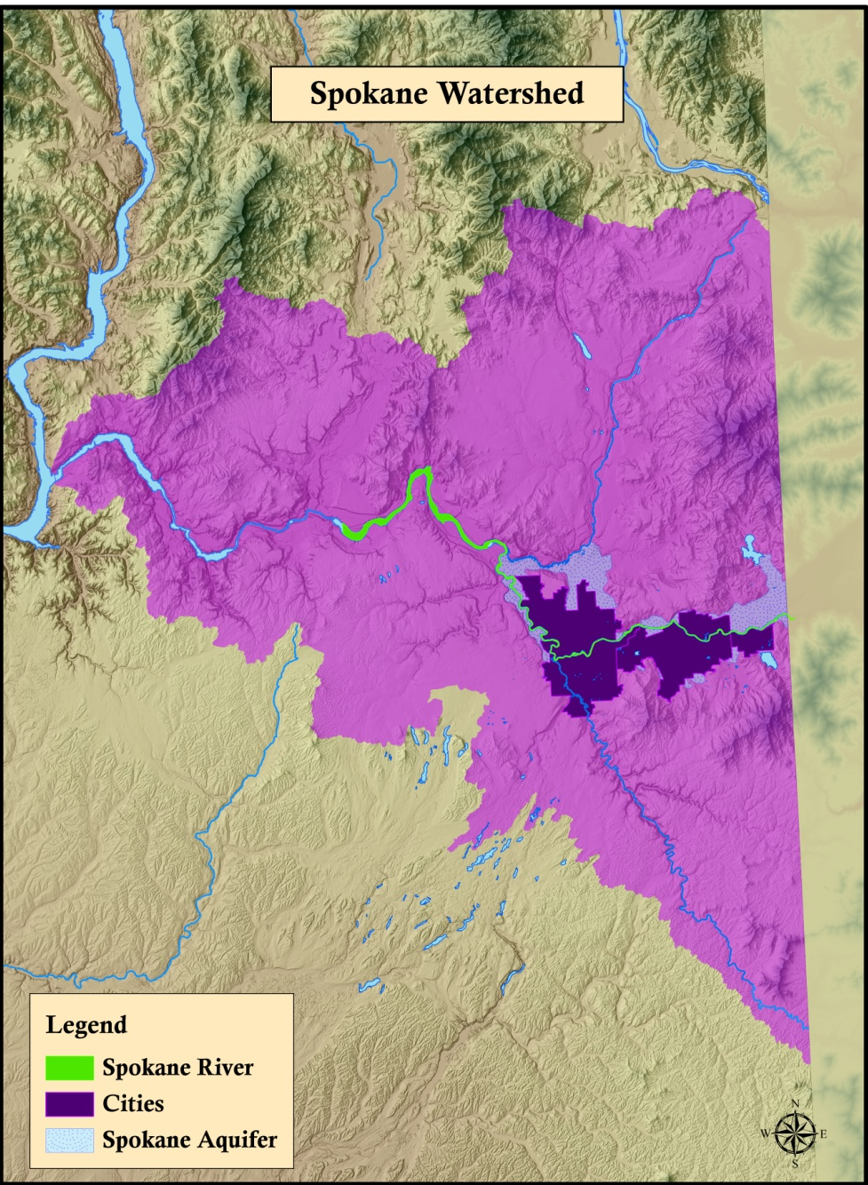
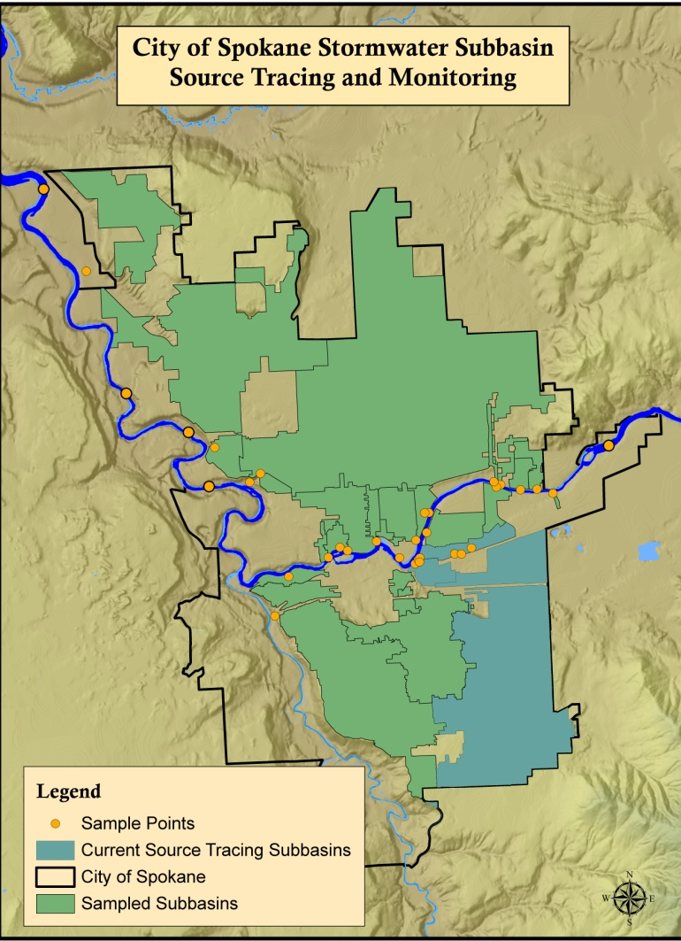
Spokane Urban Waters
PCB
PBDE
Metals
Dioxin/Furan

Slide 5
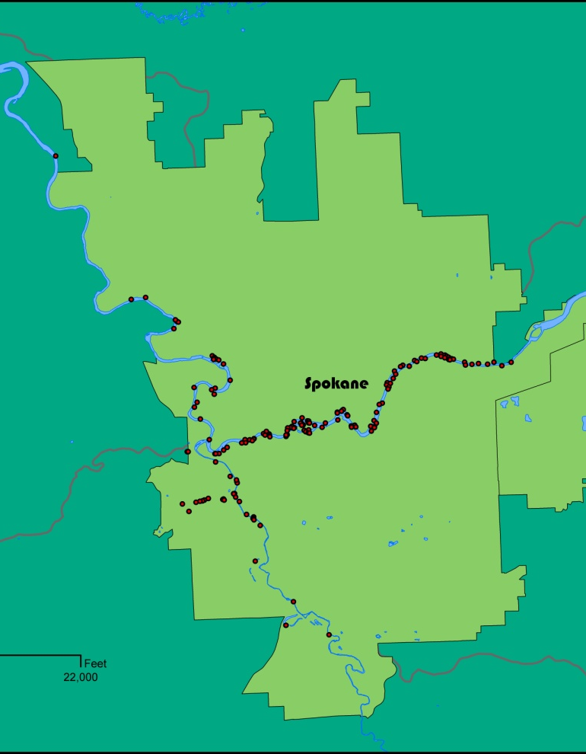
PCB Challenges
Low-level tracing
Small sources
Historical contamination
Not all data is comparable
Air deposition
“PCB-free” myth
Contaminant in everyday products
Regulatory limits
Stormwater is a source
Knowledge gaps
Human dimension
Notes:
Understand contaminant flow of each contaminant within the watersheds that feed the Spokane River and the SVRP Aquifer
Determine background concentration (natural concentrations (metals and dioxins) and aerial deposition)
Sources hard to pinpoint for PBDEs because in everyday products
Can tackle some sources but may need to find a new way to address contamination not from businesses.

Slide 6
Urban Waters Tools
* Source
Tracing
* Education
Incentives
* BMP
Implementation
Site Cleanups
Training
Facilitation
Regulation
* COLLABORATION IS KEY!
City of Spokane
Alpine Homeowners Association
Liberty Lake Sewer and Water District
Spokane Aquifer Joint Board
Spokane River Forum
Spokane Regional Health District
Spokane County
Many others
Tool Development
Permits/Enforcement
Notes:
Source tracing
Data integration
Modeling – aquifer transport model
Sampling up the pipe
Multi-media source control checklist inspections based off of a similar checklist used by Seattle Public Utilities
Contamination does not compartmentalize itself into neat packets of regulations.

Slide 7
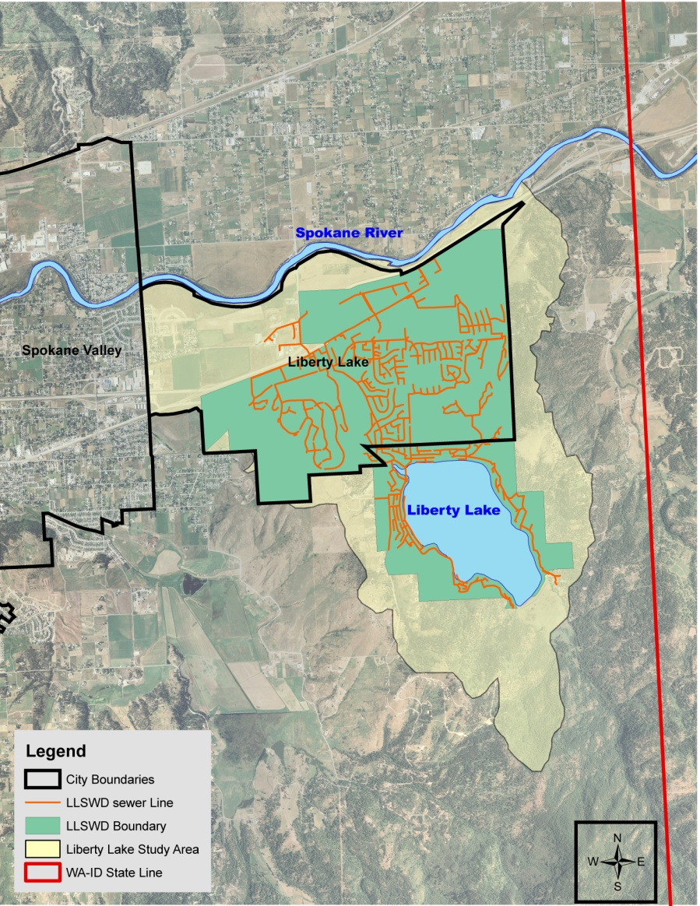
Liberty Lake Pilot Project
Purpose – Verify techniques and begin to fill CoC KNOWLEDGE gaps before entering the City of Spokane to source trace.
PCB
In all media
Similar concentration in sanitary sewer and stormwater.
Higher concentration in residential sewer water than industrial sewer water.
Higher in old residential sewer water than new residential.
Notes:
Background means the CoC concentration ranges of local urban area with no known point sources.

Slide 8
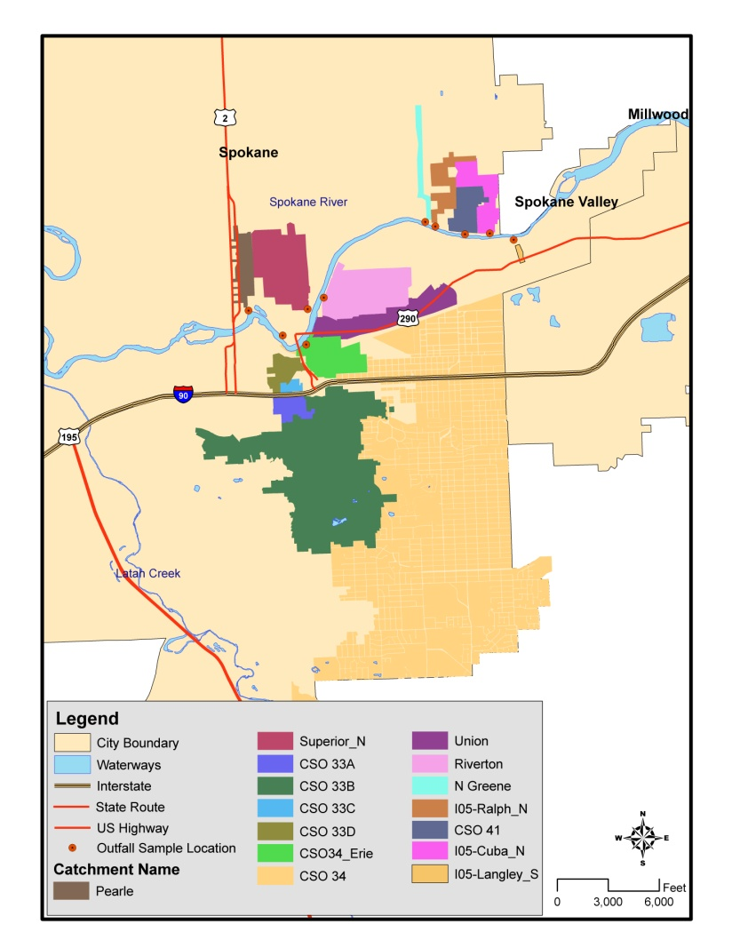
PCB Source Tracing Plan
Start in city of Spokane
Characterize more outfalls
Up-the-pipe stormwater and sanitary sewer water tracing.
  Union basin
  Combined sewer overflow #34
  Erie basin
Business visits by SRHD Local Source Control Specialist, Sandy Phillips.
Historical analysis
Current product list
Notes:
River sediment sampling – Understand movement and deposition of PBDE in river sediment…
Outfall sampling – increase the number of CSO and stormwater outfalls sampled in city of Spokane and increase knowledge of seasonal variability for current and new outfalls (besides photo, also .

Slide 9
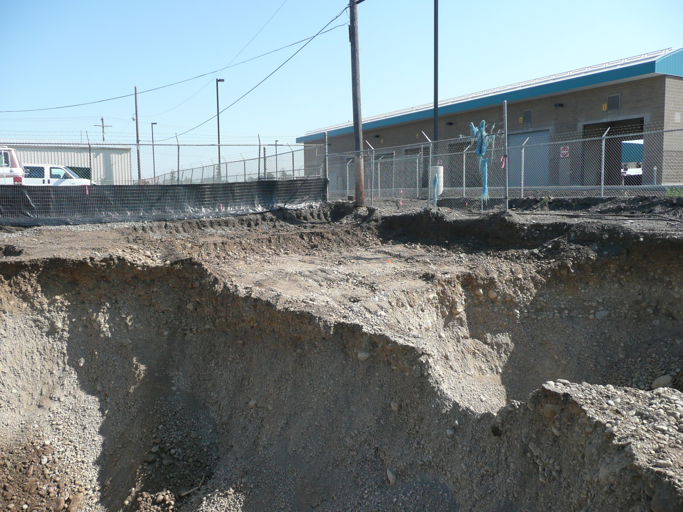
City Parcel Site
Toxics Cleanup Program PCB removal project in Union Basin
Notes:
Throughout the Spokane area the Toxics Cleanup Program also has been systematically cleaning up PCB contamination for several years. Most recently the Program completed a major PCB cleanup at an old electrical transformer repair and scrapping operation just off of Trent Avenue, known as the City Parcel Site. Last year over 8,000 tons of heavily PCB-contaminated soils and waste materials were dug up and removed from this site. The cleanup action is now complete at this property.

Slide 10
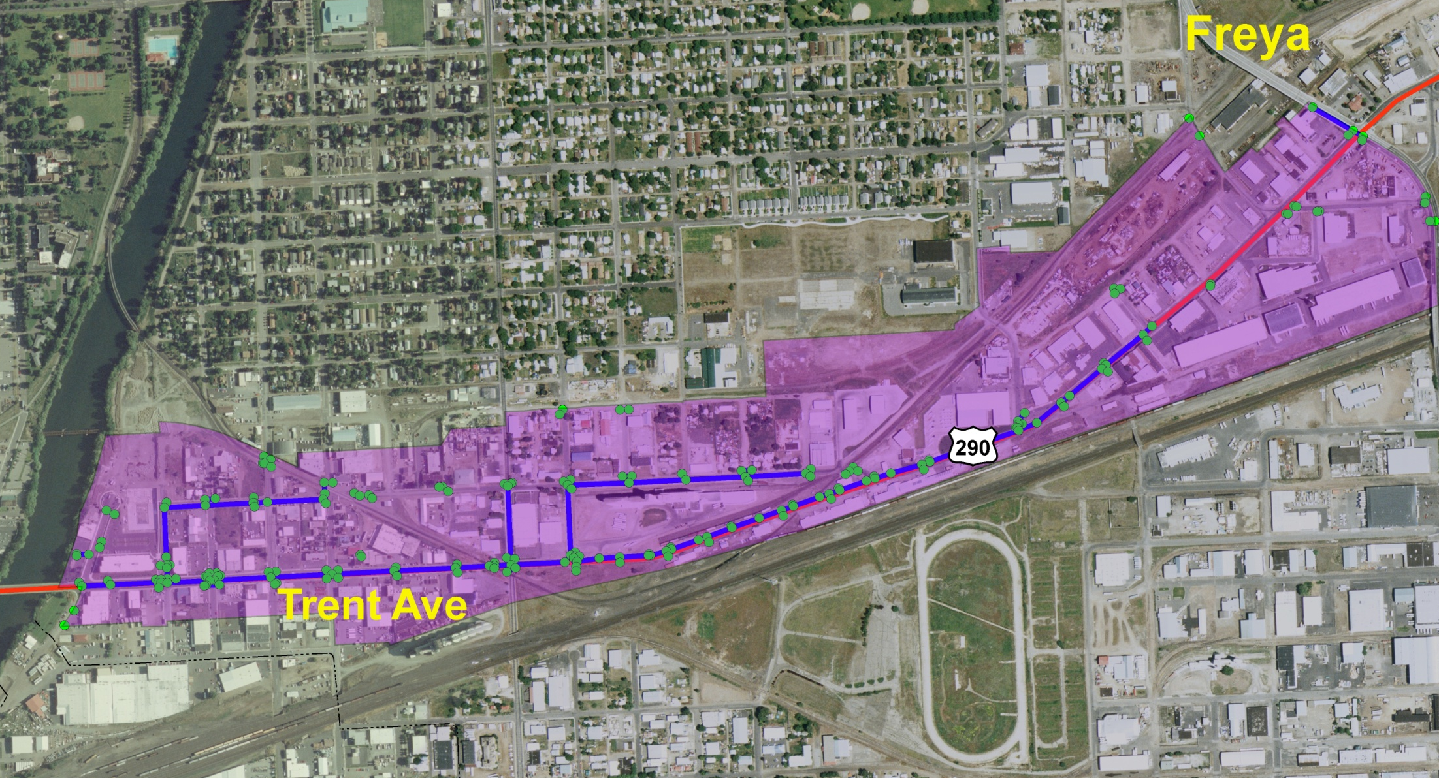
Spokane Basin Project Highlights
City Parcel collaboration and clean out in Union Basin
Notes:
Throughout the Spokane area the Toxics Cleanup Program also has been systematically cleaning up PCB contamination for several years. Most recently the Program completed a major PCB cleanup at an old electrical transformer repair and scrapping operation just off of Trent Avenue, known as the City Parcel Site. Last year over 8,000 tons of heavily PCB-contaminated soils and waste materials were dug up and removed from this site. The cleanup action is now complete at this property.

Slide 11
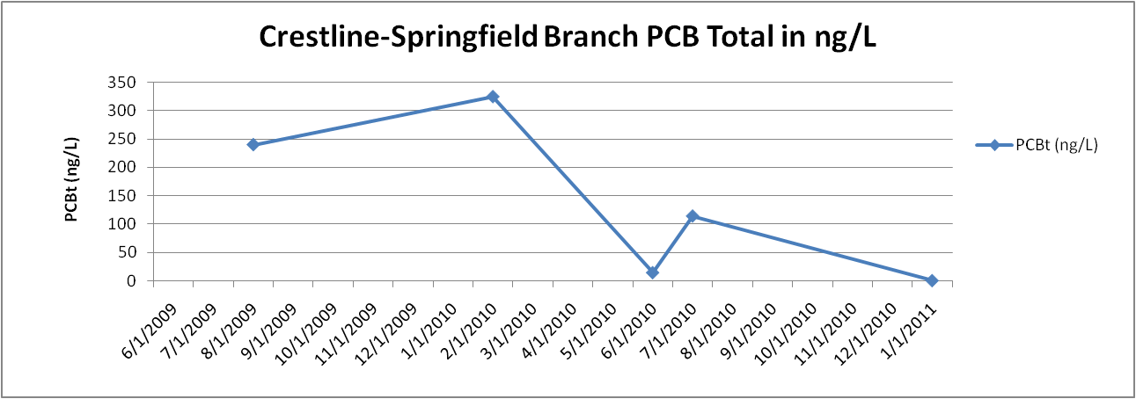
City Parcel Area Progress

Slide 12
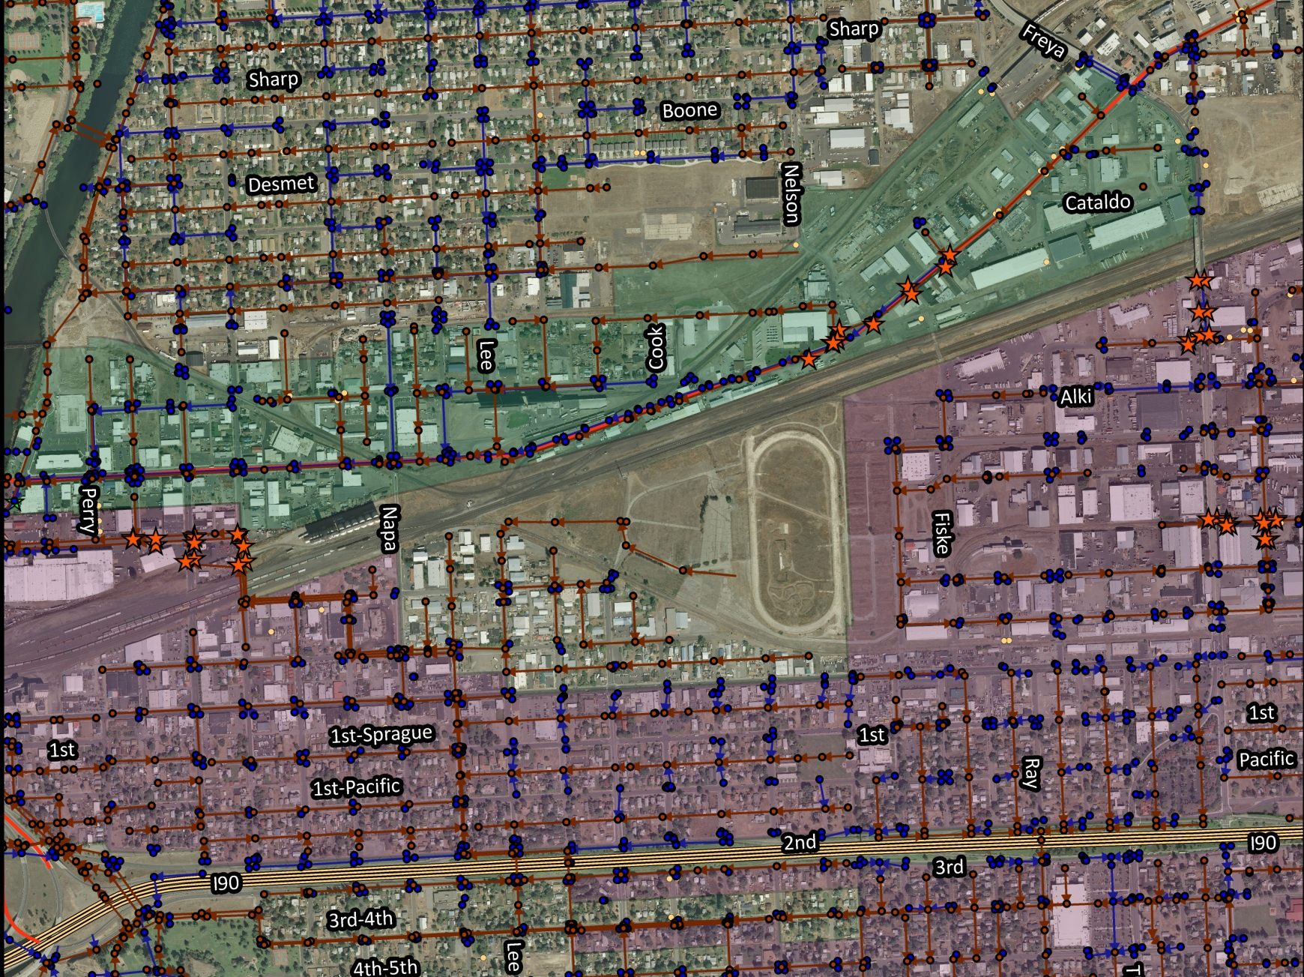
PCB Hot Spots

Slide 13
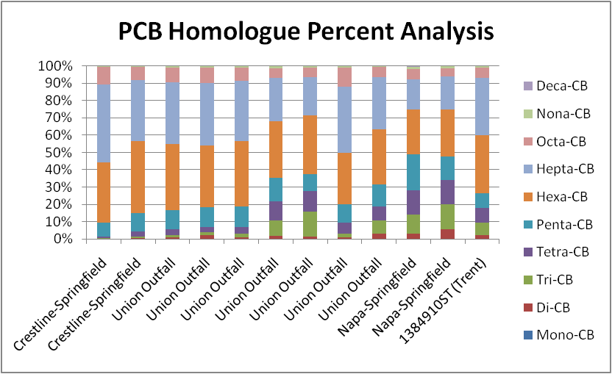
PCB Signatures

Slide 14
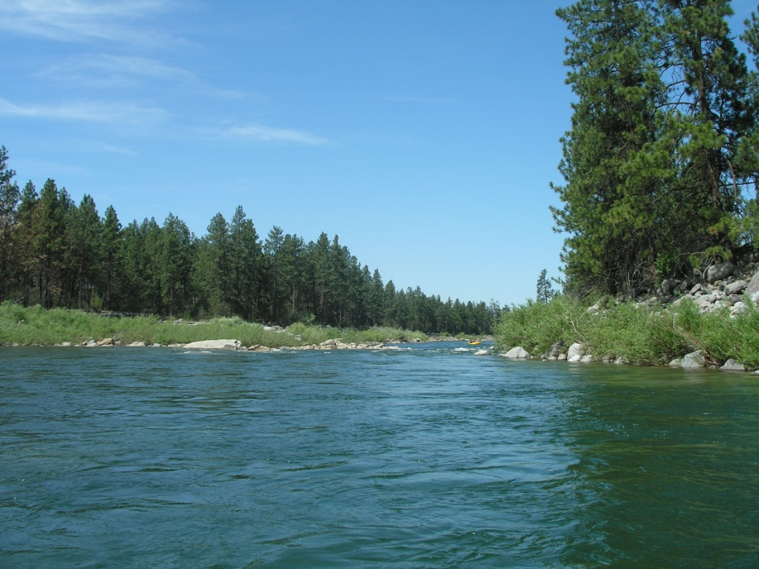
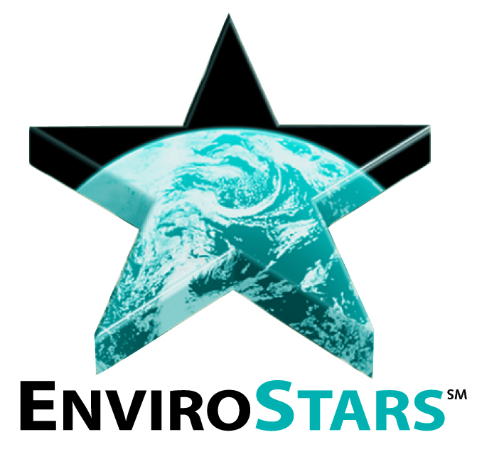
More Progress…
Be an EnviroStars Certified Business
EnviroStars Spokane pilot project to compliment Local Source Control.
Certified businesses recognized with free advertising.
Focused on proper management and storage of hazardous waste.
Implementing Partners:
  Spokane River Forum
  Spokane Regional Health District
  Spokane Aquifer Joint Board
  City of Spokane
  Ecology
Receive the recognition you deserve
for protecting the Spokane River and
the Spokane Valley – Rathdrum Prairie Aquifer

Slide 15
Contacts
Arianne Fernandez
Urban Waters Specialist
Hazardous Waste and Toxics Reduction Program-ECY
Email: afer461@ecy.wa.gov
Phone: (509) 329-3498
Ted Hamlin
Urban Waters Specialist
Water Quality Program-ECY
Email: tham461@ecy.wa.gov
Phone: (509) 329-3573
Sandy Phillips
Local Source Control Specialist
Spokane Regional Health District
Email: sphillips@spokanecounty.org
Phone: (509) 324-1572

