Slide 1
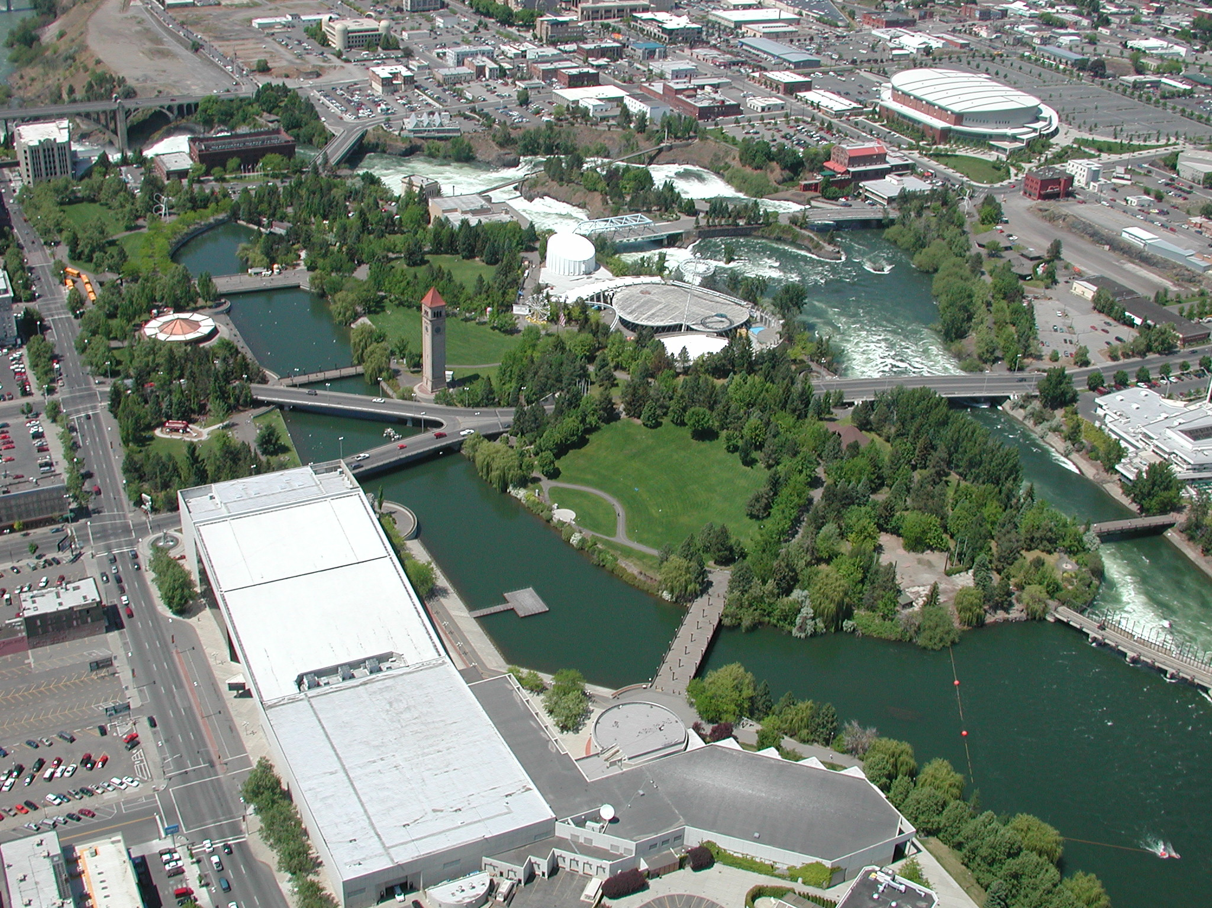

Regulatory Path Forward for Spokane River PCBs
________________________
David Moore
Washington State Department of Ecology
Eastern Regional Office

Slide 2
Standard path: TMDLs
TMDLs required where water bodies fail to meet standards (303 d list)
TMDLs have changed – increased awareness, controversy = long effort
Spokane DO TMDL – 12 years
Currently ~1600 TMDLs need to be complete within 13 years of listing
Notes:
What TMDLs used to look like (Liberty Lake and Spokane)
“attorney stimulus plan”
~1400 TMDLs have been approved since 1996

Slide 3
New path: Straight-to-Implementation (STI)
Alternate pathway for PCBs?
Components
  Source assessment study (foundation)
  WWTP permits
  Stormwater (CSOs) permits
  Urban waters tracing etc.
  Legislation
  Upland / beach cleanups
  Monitoring

Slide 4
Possible Benefits of STI
“Cleaner water faster” is the goal
Source reduction focus
  Technical background work very extensive already.
Elements already in place – ready to go and expand.
Does not preclude future TMDL pathway.
Notes:
Where do we want to put our money? Plans and lawyers or making a dent in the problem? We’ve seen the TMDL pathway, let’s try something different.

Slide 5
