Slide 1
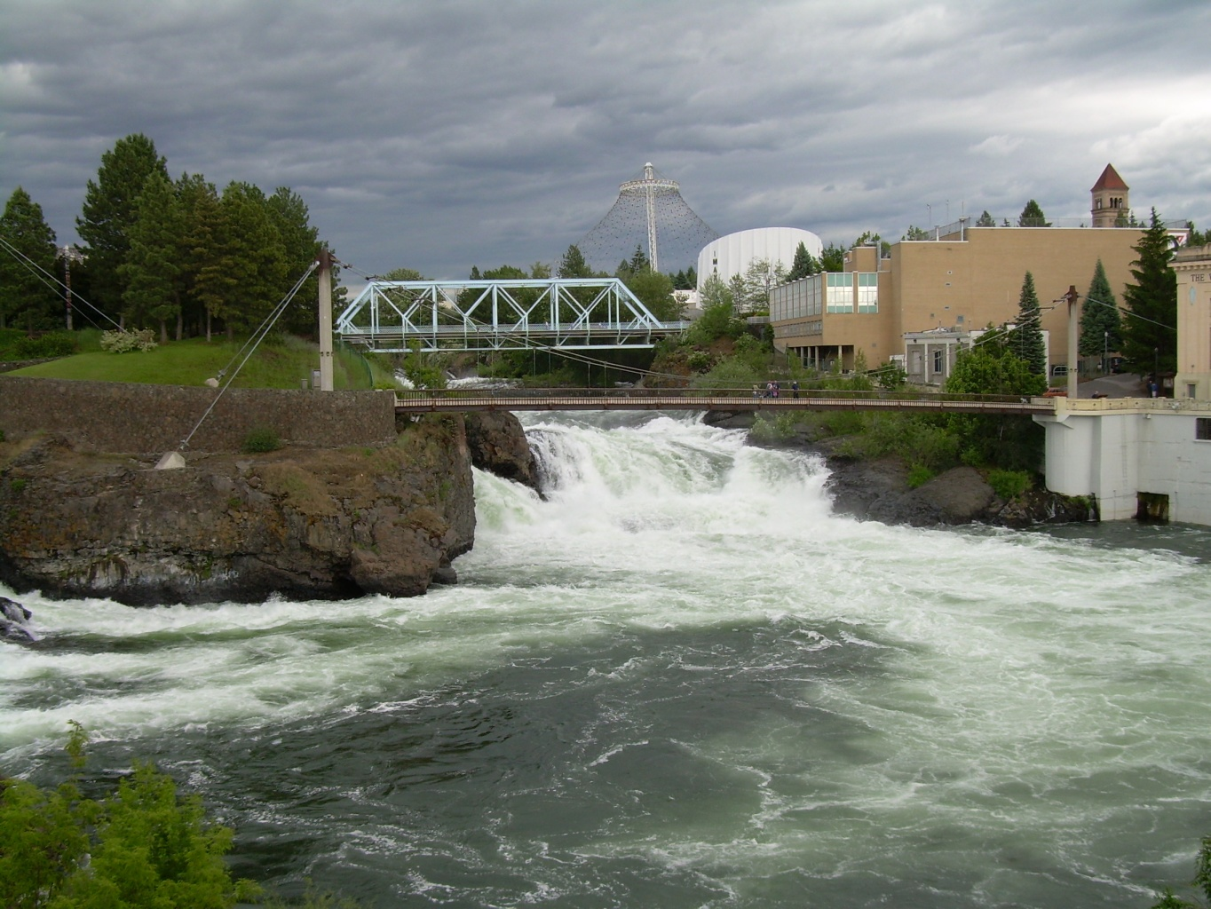
Spokane River PCB Source Assessment
Washington State Department of Ecology
Spokane River Forum May 24 2011

Slide 2
Spokane River Total PCBs in Fish Tissue
1993-1999
Max
Mean
Min
WA Standard= 5.3 ng/g
ng/g= parts per billion

Slide 3
Components of Spokane River PCB Source Assessment
Source Assessment 2003-2004
Fish Tissue Advisory Update 2005
City of Spokane Stormwater 2007

Slide 4
Sampling Overview
Sampling conducted between 2003 - 2007
River water (2003-04)
Industrial and municipal discharges (2003-04)
Storm water (2007)
Bottom sediments and sediment cores (2003-04)
Suspended particulates (2003-04)
Resident fish (2005)
Rainbow and Brown Trout, Mountain Whitefish, Smallmouth Bass, Largescale and Bridgelip Sucker

Slide 5
Study Area
RM 112
RM 0

Slide 6
Historic PCB Effluent Loading Data
1994-2002
Discharge | 1994 | 1995 | 2000 | 2001 | 2002
Kaiser Trentwood | 2300 | 2600 | 2400 | 480 | 140
Spokane WWTP | - | - | - | 260 | -
Inland Empire Paper | - | - | - | 40 | 94
Liberty Lake WWTP | - | - | - | 4.3 | -
-=Not measured
milligrams/day

Slide 7
Comparison of WWTP Effluent Concentrations of PCBs in Washington
pg/l= parts per quadrillion

Slide 8
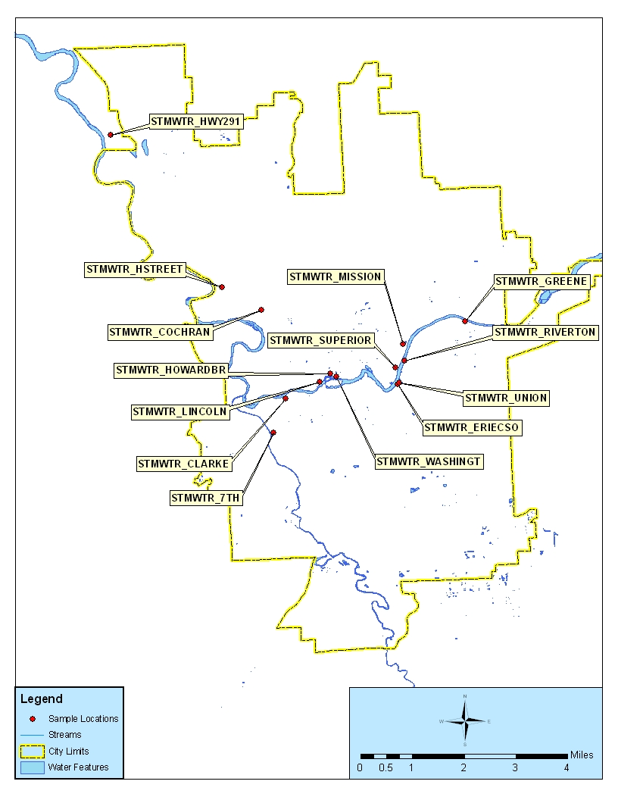
PCB Loads from City of Spokane Storm Drains
Total PCB Load= 690 mg/day

Slide 9
PCB Loading in Spokane River
2003-2004
Total PCBs, mg/day
Source | Load (mg/day)
City of Spokane Stormwater | 690
Stateline | 477
Spokane WWTP | 194
Little Spokane River | 95
Kaiser | 65
Inland Empire Paper | 45
Liberty Lake WWTP | 2.9
Idaho
477
Stateline (RM 96.1)
Washington
Liberty Lake WWTP= 2.9
Kaiser= 65= 65
Inland Empire= 45
354 (mid)
721 (bottom)
Upriver Dam (RM 80.2)
City of Spokane Stormwater= 690
1,413
Monroe Street Upper Falls Dam
(RM 74.5)
Flow
Spokane WWTP= 194
2,281
Ninemile Dam (RM 58.1)
Little Spokane River= 97
3,664
Long Lake Dam
(RM 33.9)

Slide 10
Distribution of PCB Sources
2003-2004

Slide 11
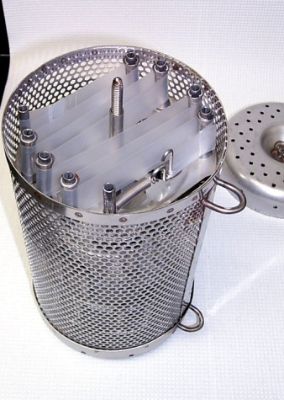
Dissolved PCBs in Mainstem
2003-2004
pg/l= parts per quadrillion

Slide 12
Reductions Needed In Spokane River to Meet Water Quality Standards
Location on Spokane River | Current t-PCB Load (mg/day) | Target t-PCB Load (mg/day) at Water Quality Criterion |  | t-PCB Load Reduction Required to Meet Water Quality Criterion
 |  | NTR (170 pg/l) | Spokane Tribe (3.37 pg/l)
 |  |  |  | NTR | Spokane Tribe
Stateline | 477 | 766 | 15 | none required | 97%
Upriver Dam | 537 | 780 | 15 |  | 97%
Monroe St. | 1,413 | 1,208 | 24 | 15% | 98%
Ninemile | 2,281 | 1,243 | 25 | 46% | 99%
Little Spokane River | 97 | 83 | 2 | 15% | 98%
Lake Spokane (lower) | 3,664 | 1,562 | 31 | 57% | 99%
Little Falls | 3,664 | 1,562 | 31 | 57% | 99%
Spokane Arm | 3,664 | 1,562 | 31 | 57% | 99%

Slide 13
Total PCBs in Spokane River Sediments
ng/g, OC= parts per billion organic carbon normalized

Slide 14
Sediment Effects at Upriver Dam
2003-2004
Dissolved Total PCBs in Surface Water
pg/l= parts per quadrillion

Slide 15
Sediment Profile for Lower
Lake Spokane
Steep declines from 1960s through mid-1980s
Concentrations have decreased by about ½ since mid- 1980s
ng/g= parts per billion

Slide 16
PCBs in Spokane River Fish
2005
Sportfish Fillets
Whole Suckers
Highest Levels near Mission Park
ug/kg= parts per billion

Slide 17
Total PCB Levels in Freshwater Fish from WA. 2001 to 2008

Slide 18
Conclusions
PCB levels in Spokane River have declined since 1990s but are still above standards and elevated compared to most other areas of Washington
PCB concentrations in water increase moving downstream from the Idaho border to Lake Spokane
The largest PCB loading to the river appears to be from storm water in the City of Spokane
To meet the Spokane Tribe water quality standard, all sources (including the river at the Idaho Border and sediments) will have to be reduced by at least 95%

Slide 19
Recommendations
Implement Spokane River Toxics Reduction Strategy
Prevention, management and cleanup
Conduct upstream source tracing within conveyance systems
Urban Waters Initiative
Conduct effectiveness monitoring to track progress in reducing PCB levels
Draft plan scheduled for early 2012

Slide 20
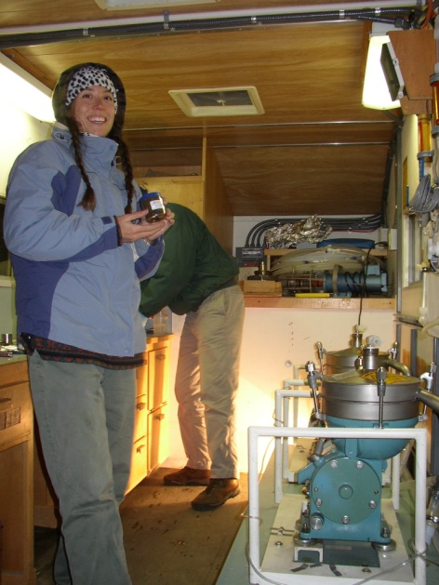
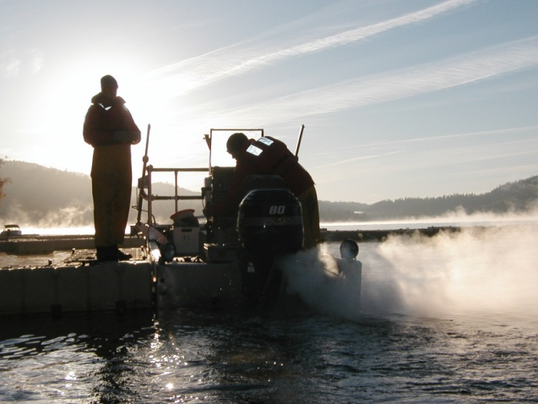
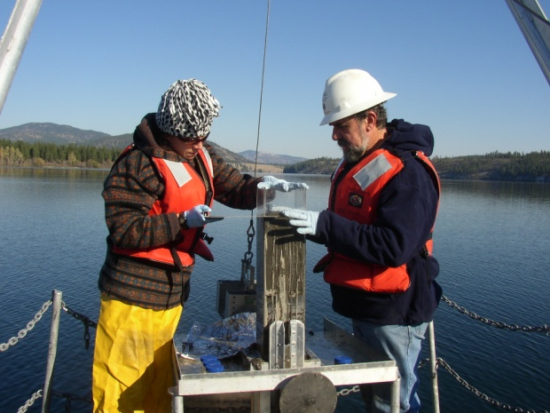
Links
Spokane River PCB Source Assessment 2003-2007
http://www.ecy.wa.gov/biblio/1103013.html
Spokane River Toxics Reduction Strategy
http://www.ecy.wa.gov/biblio/1110038.html

