Slide 1

PCB’s In The Columbia River Basin
Spokane River Forum
May 24, 2011
Spokane, WA
Mary Lou Soscia
U.S. Environmental Protection Agency

Slide 2
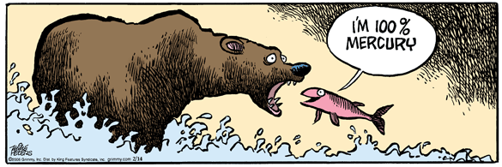
Toxics Are A Contemporary Issue
Mother Goose and Grimm – Feb. 14, 2006

Slide 3

Toxics are a Legacy Issue Women’s Day June 1, 1947

Slide 4
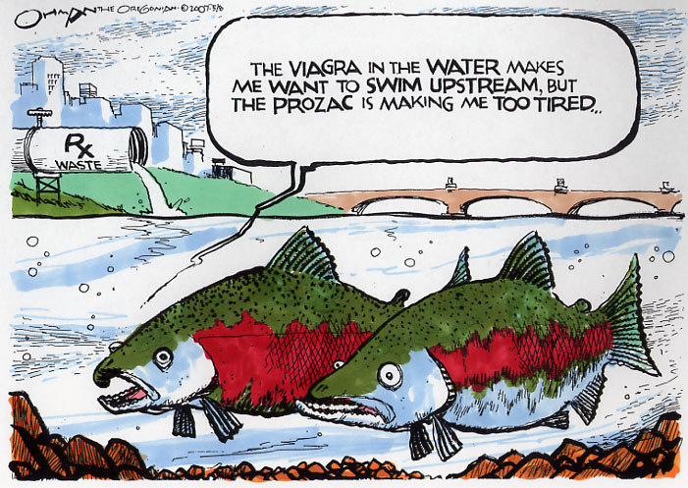
Pollution Prevention is the Key to Reduce Toxics

Slide 5
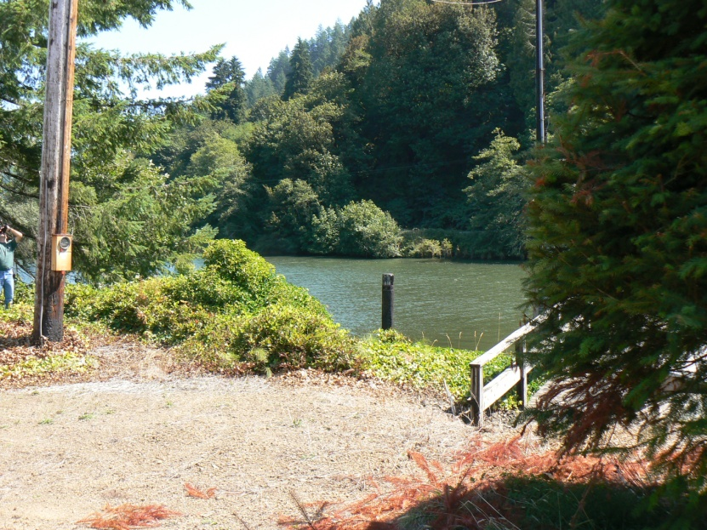
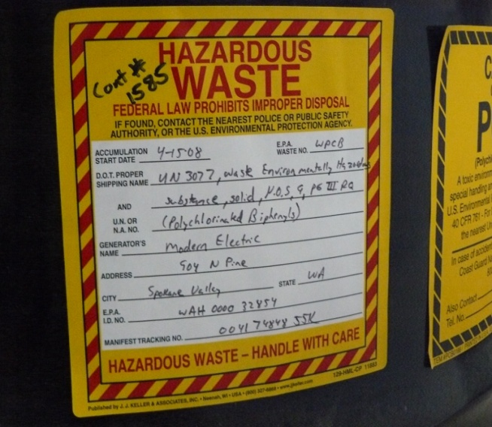
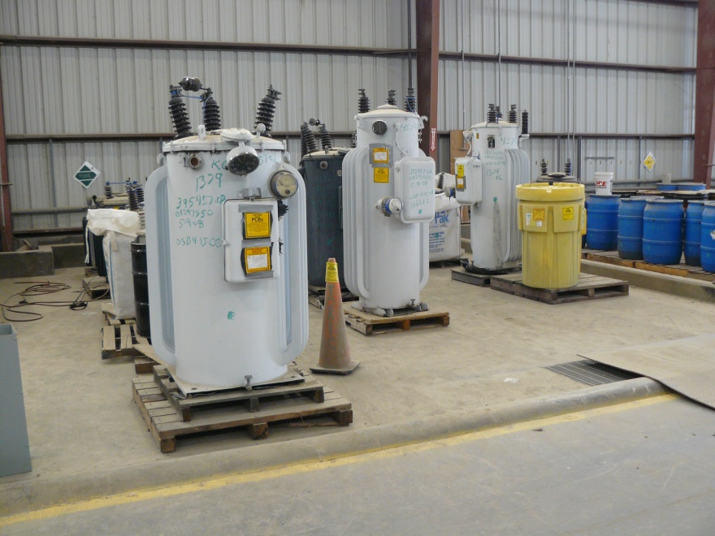
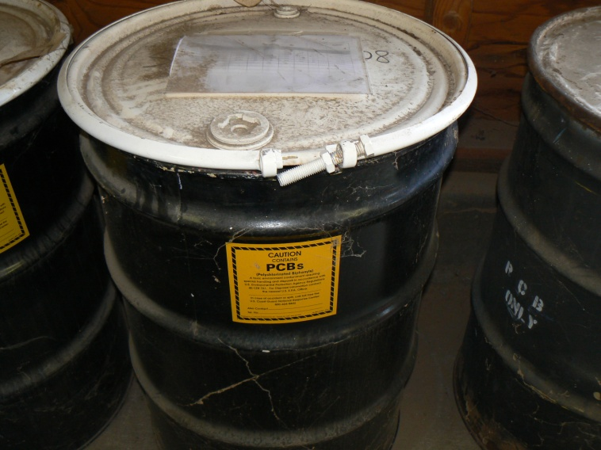
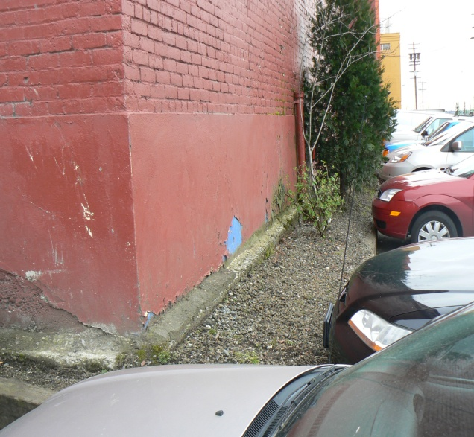
PCBS ARE NOT REALLY A LEGACY CONTAMINANT -
THEY ARE ACTIVELY CONTAMINATING THE ENVIRONMENT

Slide 6
Today’s Conversation
Columbia River Toxics Reduction Strategy
  State of River Report
  2009 PCB Workshop
  2010 Columbia River Toxics Reduction
  Action Plan
Key EPA Work Efforts
  Portland Harbor
  Hanford Reach Monitoring
  PCB Dam Inspections
  Upper Columbia River RIFS

Slide 7
Columbia River Toxics Reduction Strategy
Collaborative Watershed Effort to Reduce Toxics
Columbia River Toxics Reduction Working Group
State of River Report–“tell toxics story”
Columbia River Basin Action Plan –61 actions
Columbia River Basin legislation introduced in Congress in 2010 – toxics focus – PCBs

Slide 8
Key Partners
Federal, State and Local Govts
Columbia River Tribal Governments
Lower Columbia River Estuary Partnership
NW Power and Conservation Council
Columbia River Inter-Tribal Fish Commission,
Upper Columbia River United Tribes
Agriculture – farmers, SWCDs, NRCS
Industry - Pulp and Paper, (NWPPA), Nike, Toyota, Longview Fiber
Municipal Dischargers (ACWA)
NGOs - Columbia Riverkeeper, Oregon
Environmental Council, Salmon Safe
Local Watershed Councils

Slide 9
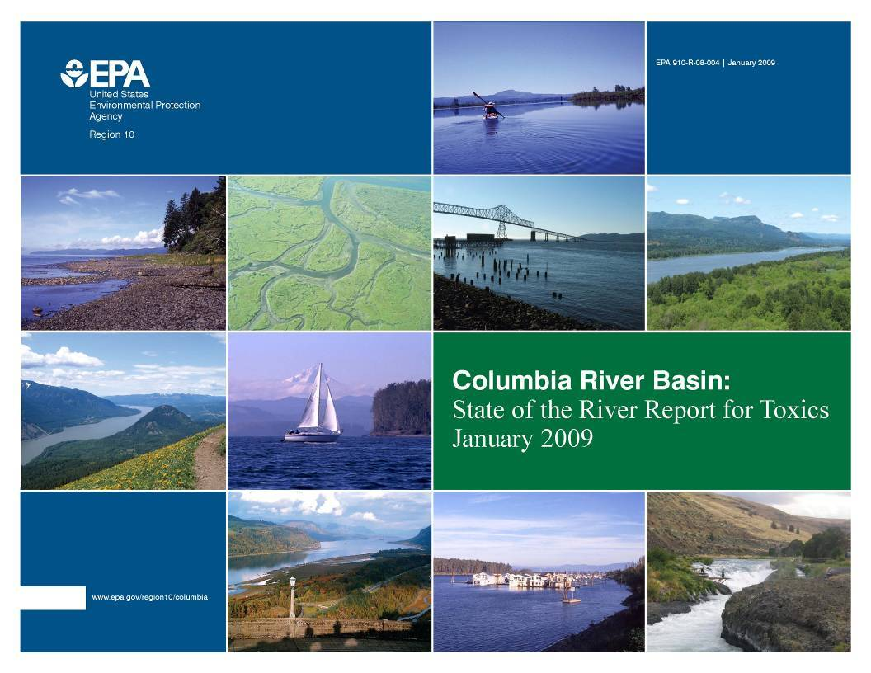

Slide 10
2009 Columbia River Basin State of the River Report for Toxics
Contaminants of Concern
Toxics are widely distributed and at levels of concern throughout Basin
Reduction efforts have been successful
Gaps in sources, effects and levels
Mercury – major source is air deposition, some regional sources
DDT – Banned in 1972, still persists
PCBs – Manufacturing banned in 1979, still widespread, learning about new sources
PBDEs – flame retardants are a growing concern

Slide 11

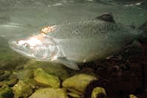
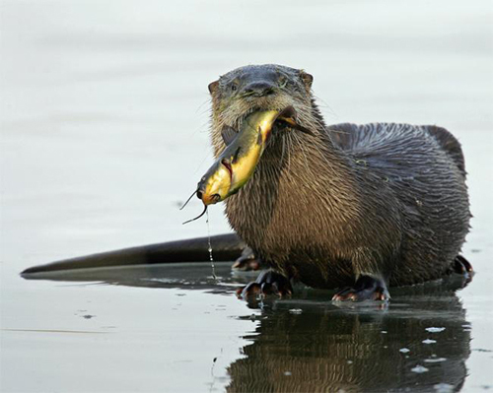
Contaminants &
Indicators
  Mercury, PCBs, DDTs, and PBDEs
Identified indicator species to track over time
Juvenile salmon
Resident fish
Sturgeon
Predatory birds – osprey and bald eagle
Aquatic mammals – mink and river otter
Sediment-dwelling shellfish – Asian clam

Slide 12
What are PCBs?
Man-made organic – “wonder chemical”
Found in electrical transformers, capacitors, other electrical equipment, stormwater
Emerging Sources: caulk, paint, paint chips, adhesives, inks and carbonless paper, lubricants, and hydraulic fluids
Build up in the environment and food chain and may harm wildlife and human health
Major dietary source of PCBs for people is fish

Slide 13
A Brief History of PCBs
1929 – First manufactured - in 1976 Congress passes TSCA – by then 1.4 billion lbs produced – half still in use and half released – EPA regs in 1979
Marking, storing, spill policy, remediation, transport, disposal, record keeping
PCBs are not a legacy – are a current use issue
Rulemaking needed to phase out currently authorized uses and TSCA reform

Slide 14
PCBs in the Columbia River Basin
Levels have generally declined, but persist at levels
of concern in many locations
Spokane River: Decrease in concentrations in resident fish between 1992-2005
Lower Columbia: Decreasing concentrations in otter/ mink livers and osprey/bald eagle eggs between 1978 &2004
Lower Columbia: Increasing as juvenile salmon travel down the estuary

Slide 15
PCBs in the Columbia River Basin
Fish advisories
  Lower Columbia [OR & WA]
  Columbia River above Bonneville [crayfish]
  Walla Walla
  Wenatchee
  Spokane
  Columbia Slough
  Willamette
  Flathead Lake
  Seeley Lake

Slide 16
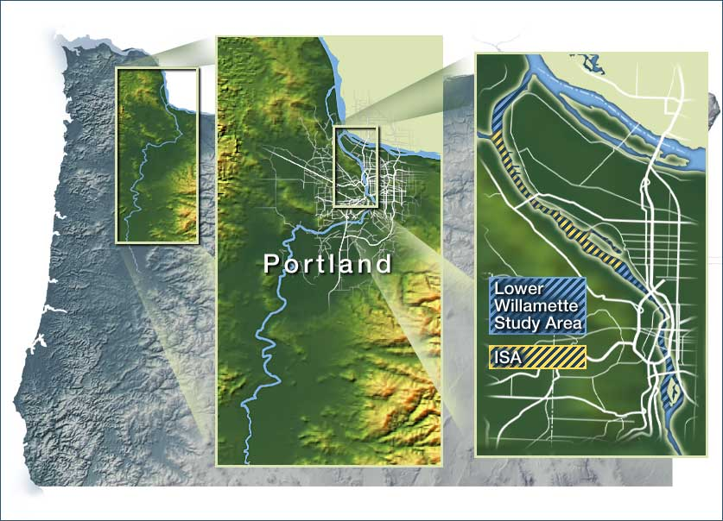

Slide 17
Portland Harbor PCBs
PH Remedial Investigation and Risk Assessments (RM 2 – 11) several areas in river sediments with elevated PCBs
PCBs drive risk at PH despite wide range of chemicals and sources
Elevated levels of PCBs detected in bass and juvenile chinook compared to upstream data
Elevated levels of PCBs in surface water associated with specific sources
Draft evaluation of sediment cleanup options due Nov 15; ongoing sources to the river being addressed by Oregon DEQ

Slide 18
Human Health Risk
Majority of Human Health Risk due to PCBs
Majority of Human Health Risk due to PCBs

Slide 19
Current AWQC = 64 pg/l

Slide 20
PCB Tissue Data - Bass
Swan Island Lagoon
Ecological Tissue TRV = 620 ug/kg
HH ATC (HQ = 1) = 80 ug/kg

Slide 21
Subyearling Juvenile Chinook
Ecological Tissue TRV (T&E Species) = 430 ug/kg

Slide 22
DOE Hanford Site Monitoring Sediment and Surface Water
Sediment: PCBs are consistently present throughout study area, generally at levels below the HHSL and ESL.. The distribution of reported values for PCBs and chlorinated pesticides suggests a non-Hanford Site source to river sediments.
For surface water (Columbia River): PCB congeners were detected in all samples, at varying concentrations. No PCB aroclors were detected in any sample.”
Notes:
From Executive Summary of “Data Summary Report for the Remedial Investigation of Hanford Site Releases to the Columbia River, Hanford Site, Washington”, WCH-398.

Slide 23
DOE Hanford Site Monitoring
Fish Tissue
For fish tissue - bass, carp, sturgeon, sucker, walleye, and whitefish:
PCBs detected in each. Total PCB levels were typically similar among 6 fish species, concentrations in walleye, whitefish, sturgeon, and carp in the Hanford Reach were somewhat higher than those observed in Upriver reference samples.
“The presence of PCBs in tissue is related to the persistence and widespread occurrence of low levels of PCBs throughout the environment.”
Notes:
From Executive Summary of “Data Summary Report for the Remedial Investigation of Hanford Site Releases to the Columbia River, Hanford Site, Washington”, WCH-398.

Slide 24
DOE Hanford Site Monitoring Fish Tissue
For fish tissue (species analyzed were bass, carp, sturgeon, sucker, walleye, and whitefish):
The concentrations of contaminants in fish fillet samples from sturgeon, whitefish, walleye, and smallmouth bass from the RI samples (2009 to 2010) compared to results from EPA 2002 Columbia River Basin Fish Contaminant Study
Comparisons are in attached table.

Slide 25
EPA 1996-1998 and 2009-2010 Analytical Results
(Modified for only PCBs)
Species | Study | PCBs²
 |  | Min | Max
Sturgeon¹ | 1996-1998 | 0.12
 | 2009-2010 | 0.088 | 0.4
Whitefish | 1996-1998 | 0.19
 | 2009-2010 | 0.0658 | 3.74
Walleye | 1996-1998 | 0.03
 | 2009-2010 | 0.0123 | 0.598
Smallmouth bass | 1996-1998 | --
 | 2009-2010 | 0.0226 | 0.233

Slide 26
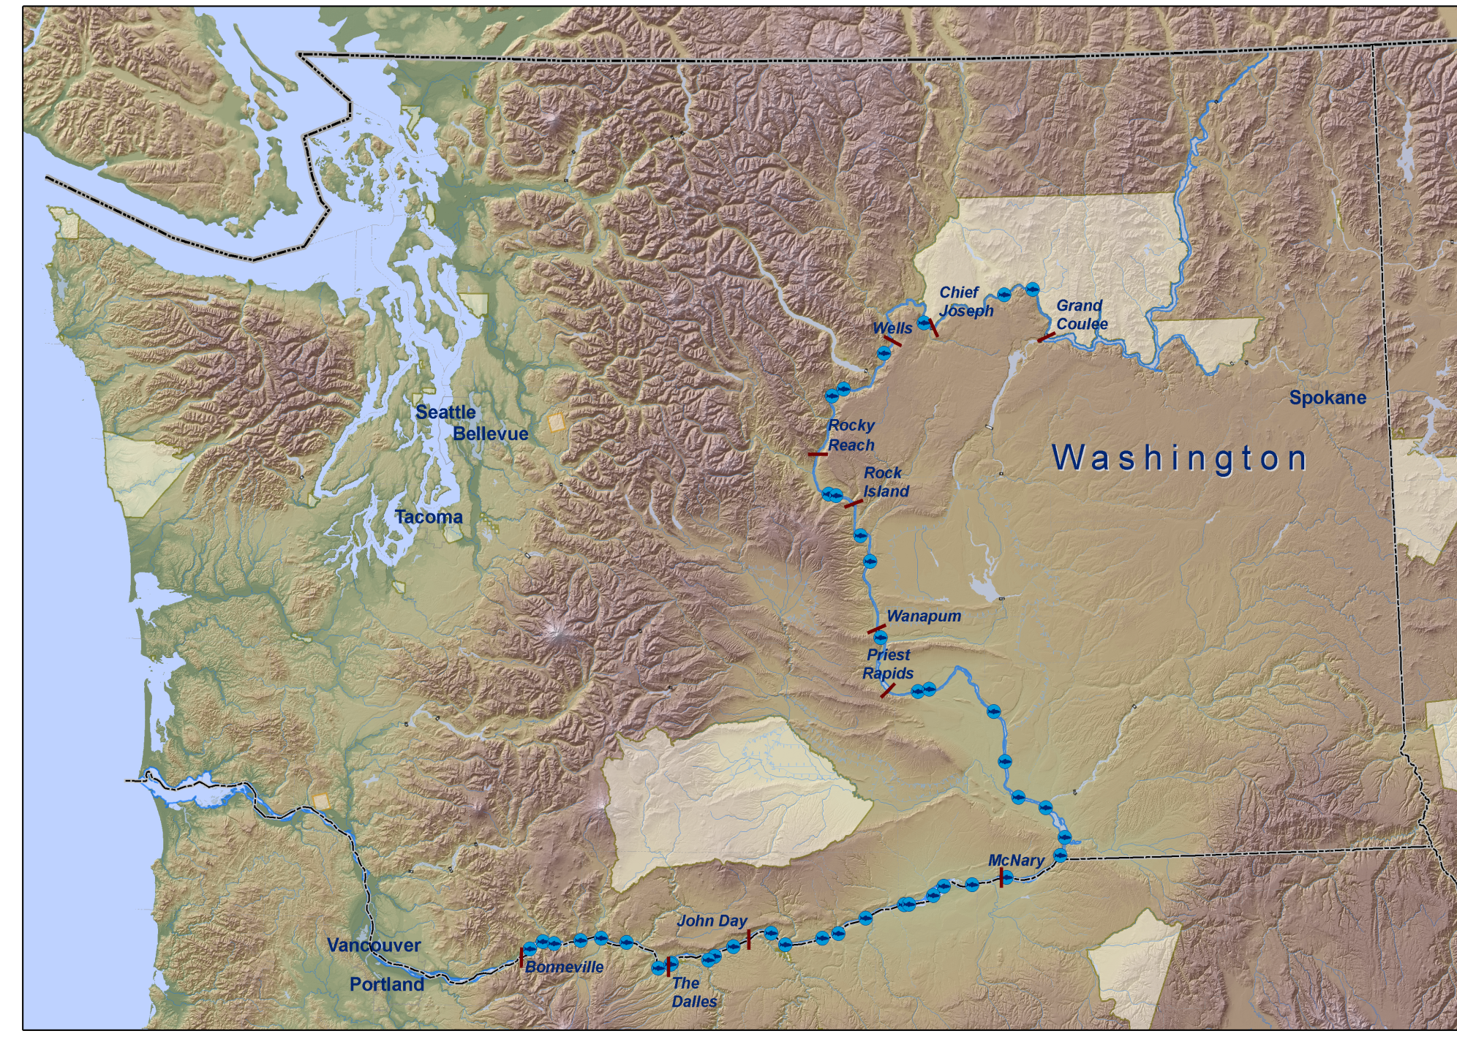
RARE Sampling – 2009 - 42 randomly-selected stations
Approx 400 river miles, alternating right and left banks
Notes:
The Regional Applied Research Effort (RARE) Program is one approach EPA takes to promote collaboration between the regions and ORD. The goals of the program are to:
Provide the regions with near-term research on high-priority, region-specific science needs,
Improve collaboration between regions and ORD laboratories and centers, and
Build a foundation for future scientific interaction.

Slide 27
Congeners Analyzed
PCB Congeners: 8, 18, 28, 44, 52, 66, 77, 81, 101, 105, 110, 118, 126, 128, 138, 153, 169, 170, 180, 187, 195, 206, 209

Slide 28
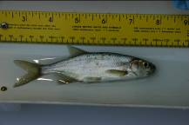
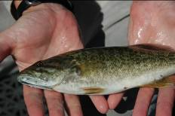
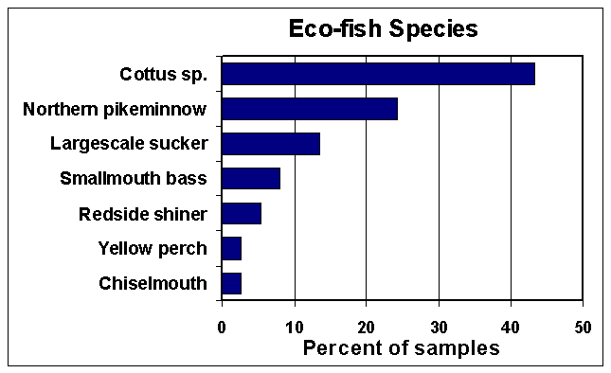
Eco-Fish Sample
Target Species: resident omnivores, <200mm in length, that are prey items to other fish species and wildlife

Slide 30

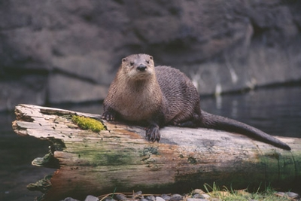
THE OSPREY AND RIVER OTTER AS SENTINEL
SPECIES FOR LONG TERM MONITORING OF
PCBS ALONG THE LOWER COLUMBIA RIVER
Robert A. Grove, Ph.D. Contaminants Program
U.S. Geological Survey, Forest and Rangeland Ecosystem Science Center,
3200 SW Jefferson Way, Corvallis, OR 97331
Notes:
Worldwide distribution (comparable data many locations)
Diet almost exclusively live fish captured near the nest
Long-lived and high nest fidelity.
Large stick nests easily located and spaced at regular intervals along rivers
Nests on artificial structures in urban areas with easy nest access
Tolerates short-term nest disturbance during collection of sample egg
Sensitive to many contaminants with “effect concentrations” known.
Lay extra egg which is rarely fledged (sample egg collection has minimal effect)

Slide 31
“
Recent data from USGS confirm the decline in PCB concentrations in both osprey eggs and river otter livers from multiple locations along the mid and lower reaches of the Columbia.

Slide 33
Upper Columbia Remedial Investigation Study
PCBs were measured in fish and levels were very low
PCBs were studied in water – no violation of drinking water or human health criteria

Slide 34
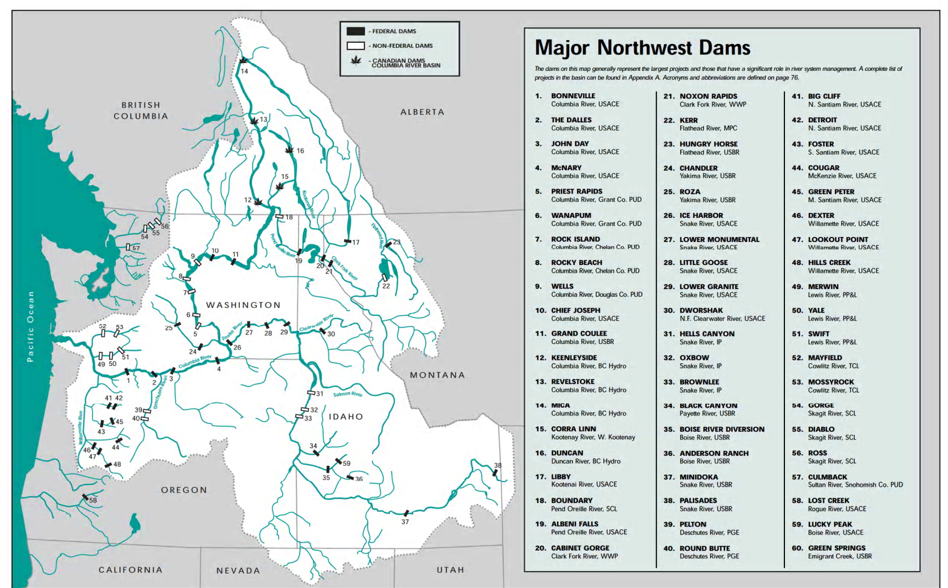

Slide 35
Federal Dams PCB Inventory
EPA met with the Corp, BoR, and BPA in Dec 2008 to discuss potential PCB sources at federal dams
Agreed that much progress has been done to remove sources, but efforts not well-documented for agency/public review
Agreed to inventory and report PCB sources to EPA

Slide 36
TSCA Information Request
EPA Info Request to Corp and BoR sent July 2006 asking for:
1) Records and reports required under the Toxic Substances Control Act - PCB Rules
  PCB Items (any PCBs), Transformers > 500 ppm, PCB Activity (spills and disposal), Storage of PCB equipment

Slide 37
TSCA Information Request
2) Information on any other known sources of PCBs that may release PCB to Columbia River
  Caulk, paint, cables, fluids, etc.
3) Description of activities being taken to further identify and mitigate PCB sources

Slide 38
Corp of Engineers Response
Dramatic reduction of PCBs since 1977
Limited number of capacitors at 2 sites
  Libby (12) and Albeni (10), possible removal
2 xformers at Bonneville (since removed)
High Voltage Bushings
  Dalles and John Day until end of useful life
Not aware of non-traditional sources

Slide 39
Bureau of Rec. Response
Aggressive removal of PCBs since 1980’s
Many transformers removed or retrofitted
13 others scheduled for disposal
No other PCB Items
All capacitors treated as with PCBs
All oil-filled cables tested before disposal
Sampling paint to determine if PCBs

Slide 40
Next Steps
Information Requests and/or TSCA-PCB inspections at non-federal dams
Similar approach as fed dams
FY 2011 – 12
Prioritize based on previous compliance, spills, proximity to higher PCB levels in CR – 4 high priority dams

Slide 41
July 2009 PCB Workshop
“PCBs ARE NOT a LEGACY CONTAMINANT “
Complete Portland Harbor clean up and expand to other sites in Columbia
Look beyond traditional PCB sources, ie, paint and caulk
Complete Federal Dam Inventory
Evaluate PCBs from non-federal dams
Increase efforts to decrease soil erosion (construction activities)
Conduct long term monitoring and identify hot spots for clean-up
Increase source loading work, i.e. stormwater tracking

Slide 42
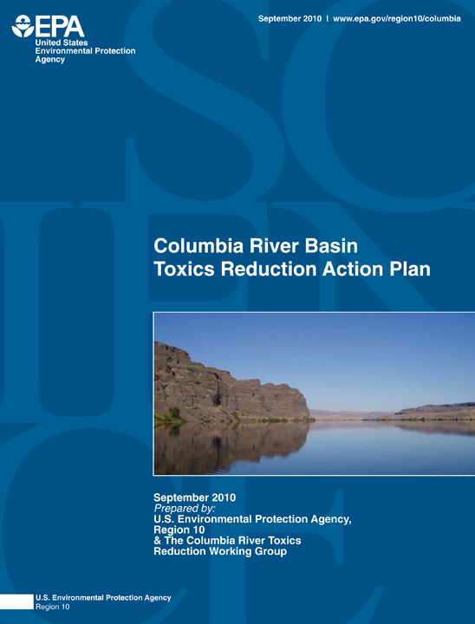

Slide 43
Columbia River Basin Toxics Reduction Action Plan – 61 Actions
5 Initiatives
  Increase public understanding & political commitment
  Increase toxic reduction actions
  Increase monitoring to identify sources
  Develop research program
  Develop data management system
2 Tiers
  Existing re$ource$
  New re$ource$

Slide 44
Examples of Actions
Increase public understanding & political commitment
  Continue Working Group
  Establish Executive level collaboration & affect national dialogue
Increase toxic reduction actions
  More leadership needed on pollution prevention and green chemistry
  Collection programs – pharmaceuticals, pesticides, mercury
  Agriculture programs – sediment reduction, Integrated Pest Management, Pesticide stewardship partnerships

Slide 45
More Actions
  Increase monitoring to identify sources
    Identify contaminants of concern for priority focus
    Identify sources of contamination & establish toxics
    reduction efforts which includes effectiveness monitoring
  Develop research program
    Convene scientists to develop Columbia River research plan
    Conduct research based on research plan priorities
  Develop data management system
    Create data stewardship program hosted and managed by a single entity

Slide 46
Columbia River Toxics Reduction Challenge
Take professional and personal responsibility to reduce toxics
Take 2 of the 61 actions – one personal and one professional
We are planning an annual report in September – please report back your successes and accomplishments to me –
Soscia.marylou@epa.gov

Slide 47
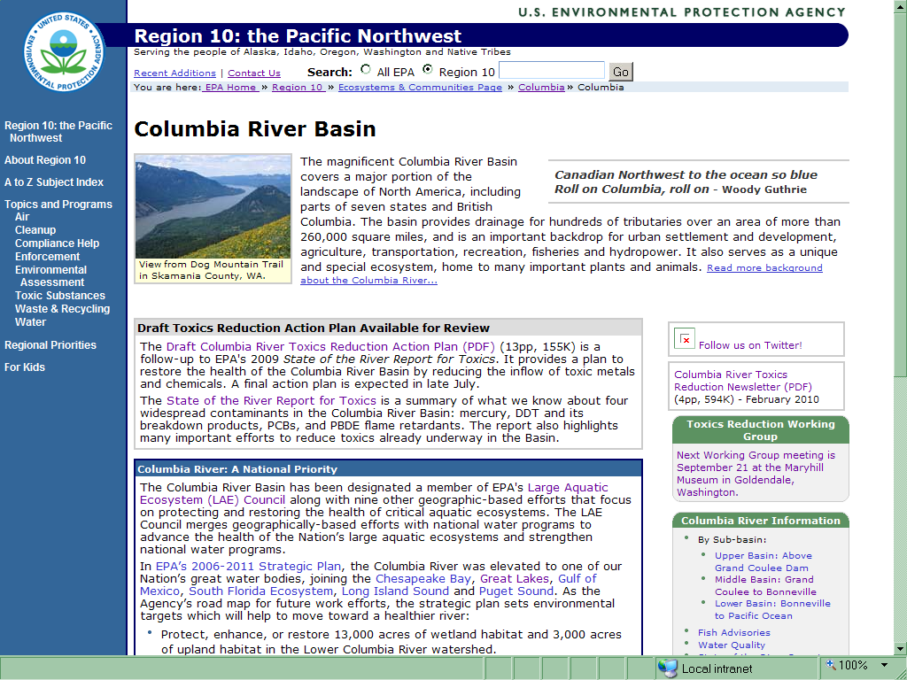
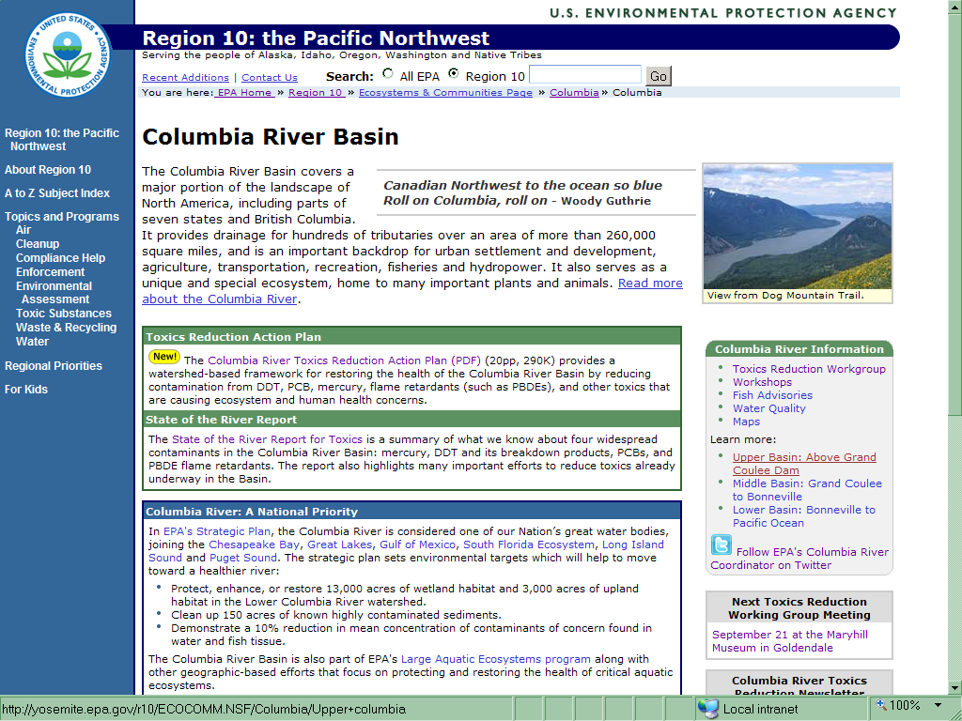

Slide 48
