Slide 1
Hangman Creek TMDL Implementation
Spokane River DO Advisory Group Meeting
January 19, 2012
Elaine Snouwaert – WA Department of Ecology
Walt Edelen – Spokane Conservation District

Slide 2
Overview
Ecology and Spokane Conservation District partnered on the project.
Covers Fecal Coliform Bacteria, Temperature, and Turbidity (Sediment) impairments
Does not cover Dissolved Oxygen, pH (or set nutrient limits)
Implementation primarily addresses nonpoint source pollution and stormwater
Implementation expected to also reduce nutrients including phosphorus

Slide 3
Schedule
TMDL efforts began in 2004 (study 2004-2005).
Data analysis and work with advisory group 2005-2008.
Spring 2009 published TMDL
September 2009 EPA approved TMDL
Worked with many implementation partners to develop Implementation Plan (completed May 2011)
Parameter | ½ to WQ Standards | Meet WQ Standards
Fecal Coliform | 5 years | 10 years
Temperature | 15 years | 25 years
Turbidity/Sediment | 7 years | 15 years

Slide 4
Implementation Focus
Advisory Group Identified 11 primary issues:
Sediment/nutrients from agricultural operations.
Sediment/fecal coliform from livestock and wildlife.
Nutrients/chemicals from residential uses.
Sediment/nutrients from agricultural field ditches.
Nutrients/fecal coliform from improperly functioning septic systems.
Sediment from gravel and summer roads.
Sediment from sheer or undercut banks.
Sediment/fecal coliform from stormwater.
Sediment from poor forestry management.
Sediment from roadside ditching.
Solar heating from lack of riparian shade.

Slide 5
Implementation Activities
Converting conventional farming tillage practices to direct seed tillage.
Implementing agricultural best management practices (BMPs) to reduce erosion.
Enhancing and restoring riparian buffers.
Managing livestock to prevent their waste from reaching streams.
Maintaining and repairing failing septic systems.
Stream bank restoration projects.
Following forest practice regulations when harvesting timber.
Education about water quality issues and the activities to address them.

Slide 6
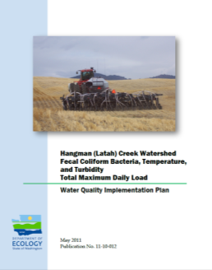
Implementation Partners
Avista Corporation
City of Spokane
Coeur d’Alene Tribe
Hangman Watershed Implementation Team
Inland Northwest Land Trust
The Lands Council
Natural Resources Conservation Service
Pine and Spokane Conservation Districts
Spokane County
Spokane Regional Health District
Spokane River Forum
Small Towns in the Watershed
Trout Unlimited and Spokane Fly Fishers
Washington Depts of Ecology, Natural Resources (forestry), Transportation (stormwater)

