Slide 1
DO TMDL
Tool Box Implementation Schedule
DO TMDL Subcommittee Meeting
June 19, 2012

Slide 2
Purpose for the Schedule
Develop the Compliance Toolbox to meet permit schedules
Allocate and schedule Ecology resources for review and approval of the tools
Provide adequate time for dischargers to address technology questions

Slide 3
Strategy
Use existing frameworks and formats to develop tools
Spokane River DO TMDL Compliance Toolbox Manual Format
Department of Ecology Draft Trading Framework
Prioritize tools based on the following criteria:
In use and generally accepted
Of mutual benefit to all or most dischargers
Regulatory policy is clear
Science and technology questions resolved
Ability to implement in a timely fashion

Slide 4
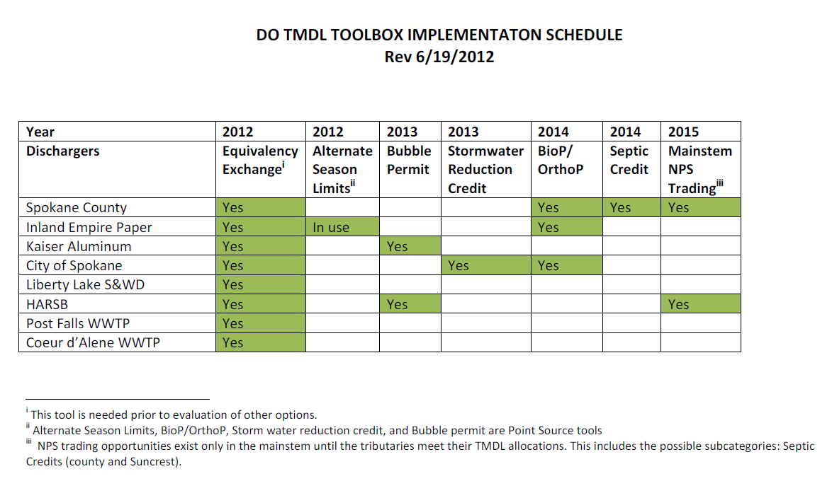
Schedule

