Slide 1
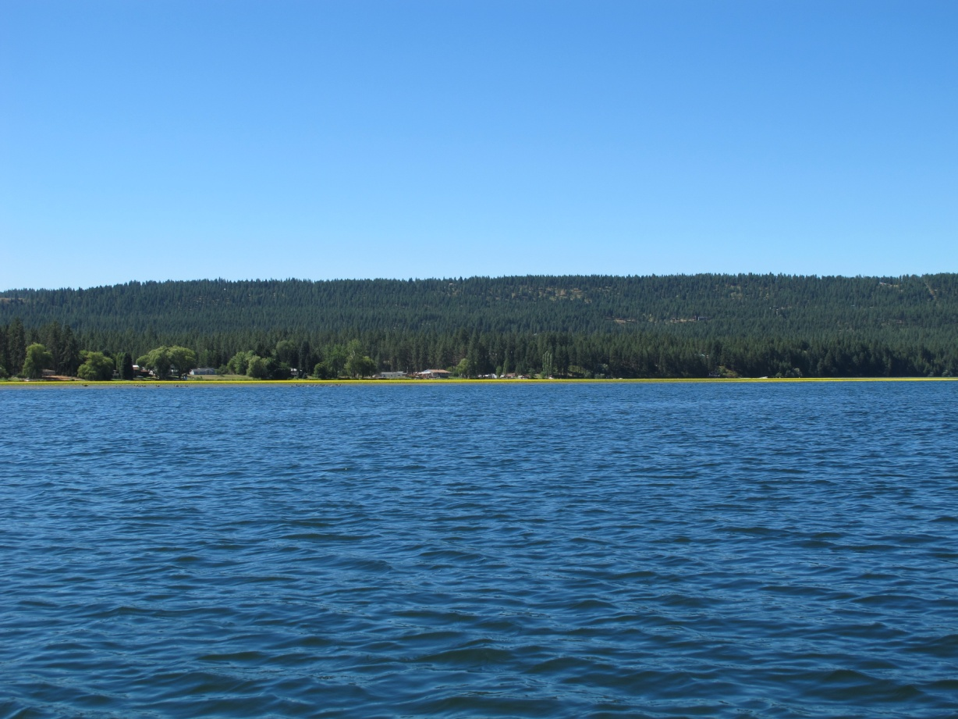
Spokane River Basin Monitoring

Slide 2
Spokane Basin Monitoring

Slide 3
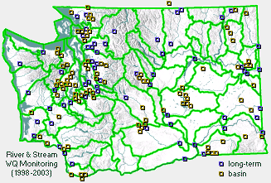
Ecology River and Stream Water Quality Monitoring
http://www.ecy.wa.gov/programs/eap/fw_riv/rv_main.html

Slide 4
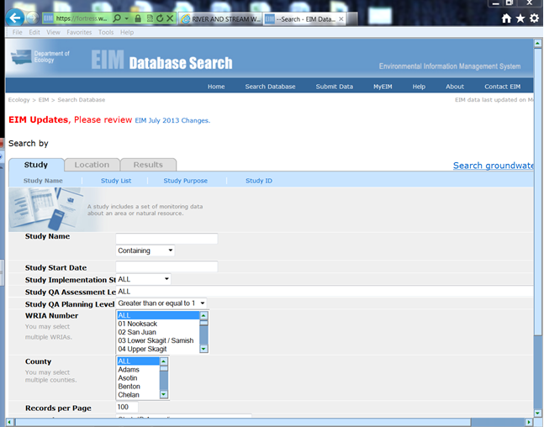
Ecology’s EIM database: https://fortress.wa.gov/ecy/eimreporting/Search.asp?Type=StudyName

Slide 5
Major Tributaries Total Phosphorus
Hangman Creek
Little Spokane River

Slide 6
Hangman Creek flows 2001 v 2011
2001
2011

Slide 7
Little Spokane River Flows 2001 v 2011
2001
2011

Slide 8
2010 Flow Weighted Phosphorus

Slide 9
Spokane River Flow May 2010- Oct 2012

Slide 10
2010 Lake Spokane Profiles @ LL0
June 1
August 30

Slide 11
2011 Lake Spokane Profiles @ LL0
June 6
August 22

